Slide 1
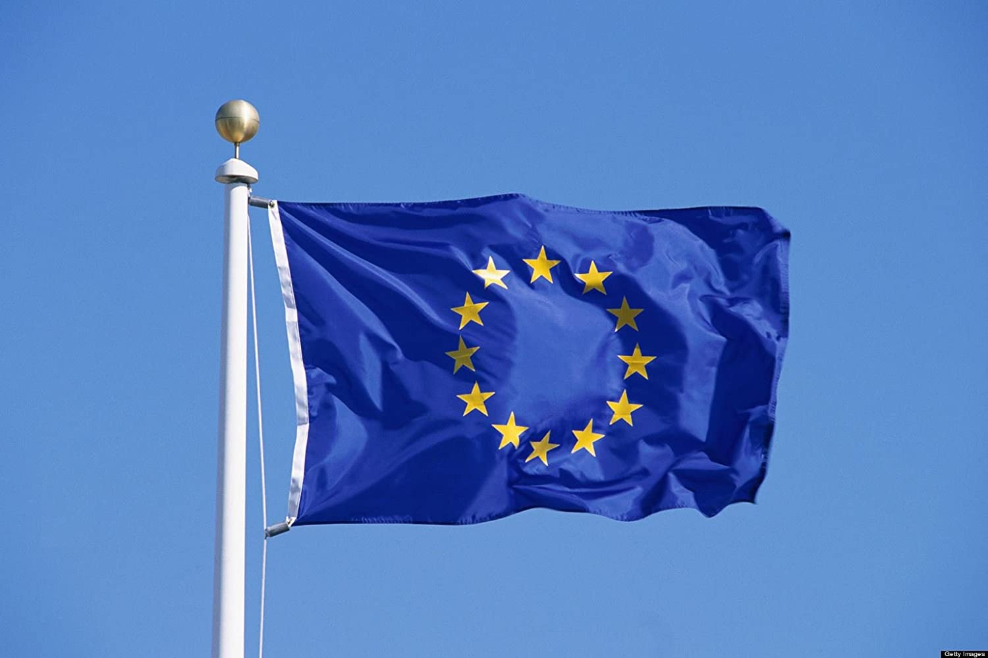
Discussion with Ing. Edit Bauer, CSc.
Szolgay Bence, Baráth Ádám, Baráth Tamás
2021 - Slovakia

Slide 2
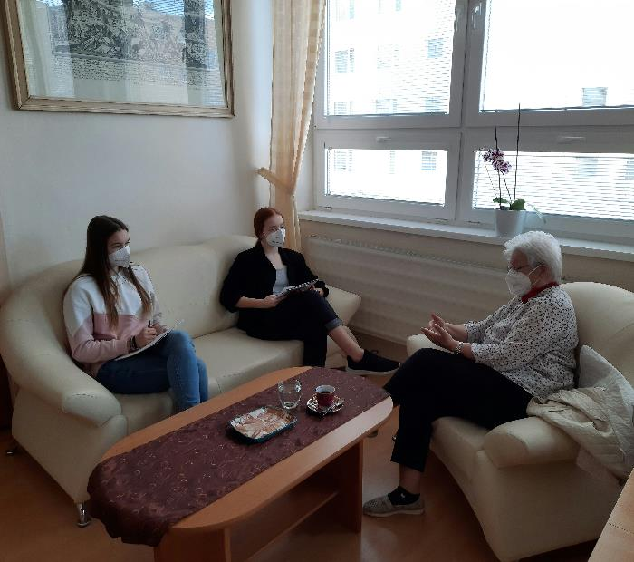
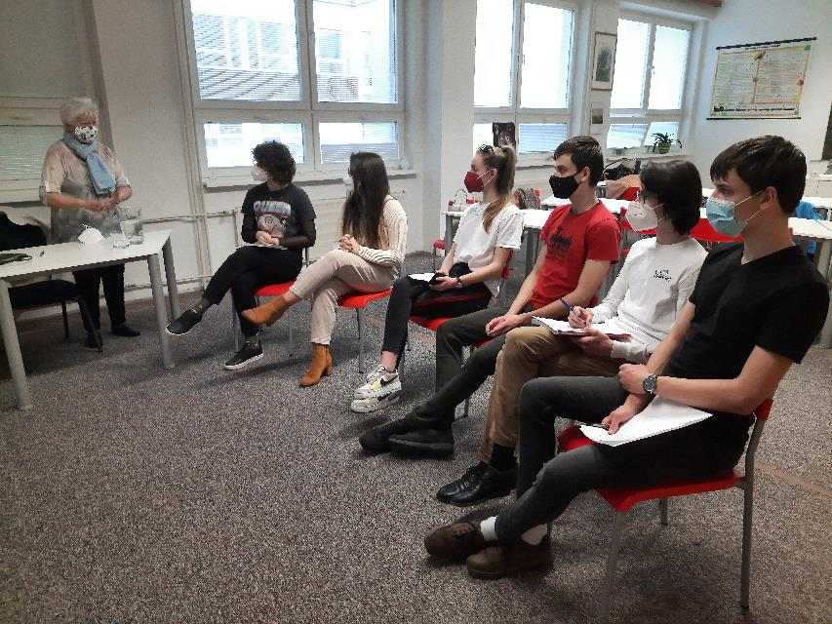
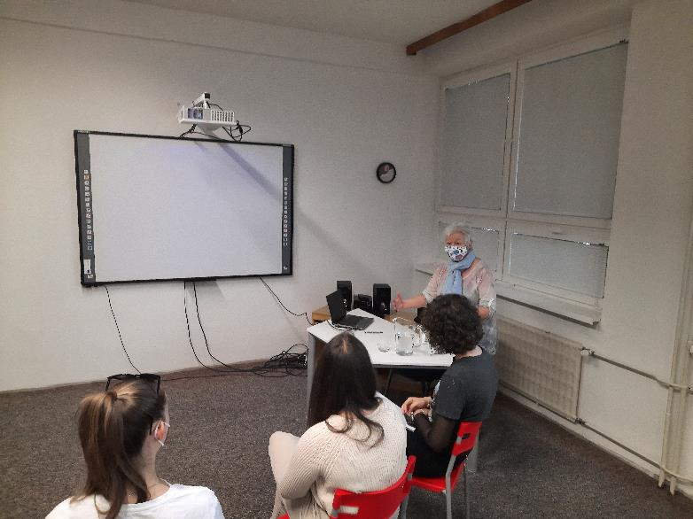
On April the 20th and 23th we had a discussion with Ing. Edit Bauer CSc., former slovakian representative in the European Parliament. We talked about several interesting topics, we prepared some questions for her.

Slide 3
Here are the most interesting questions and answers!

Slide 4
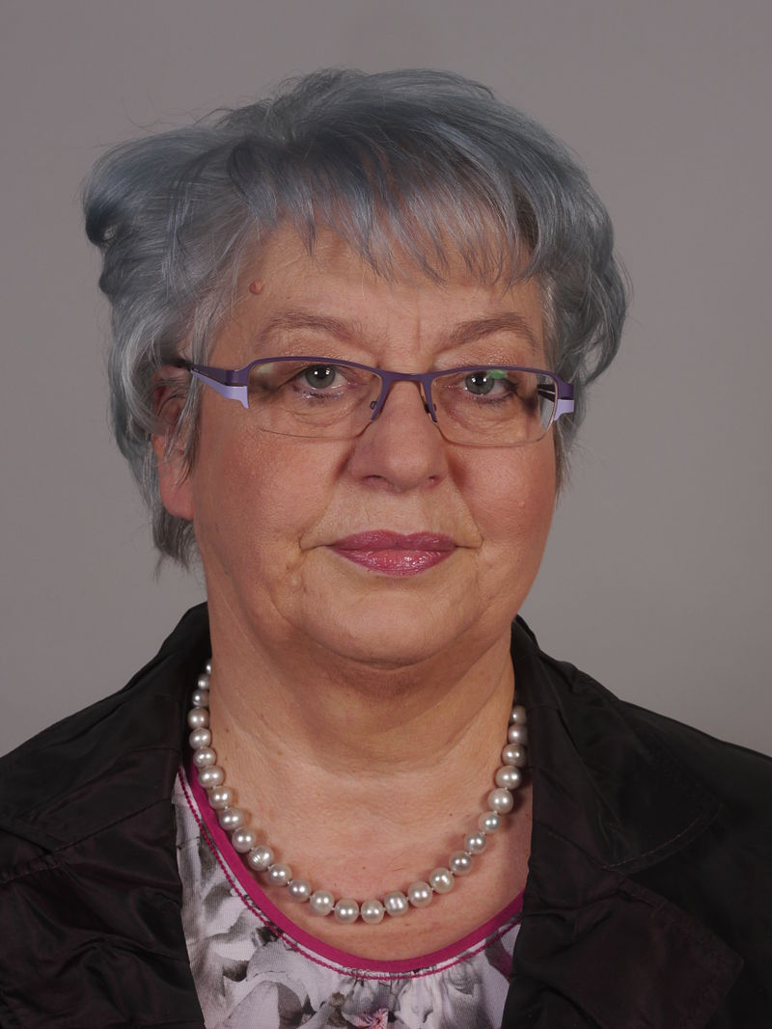
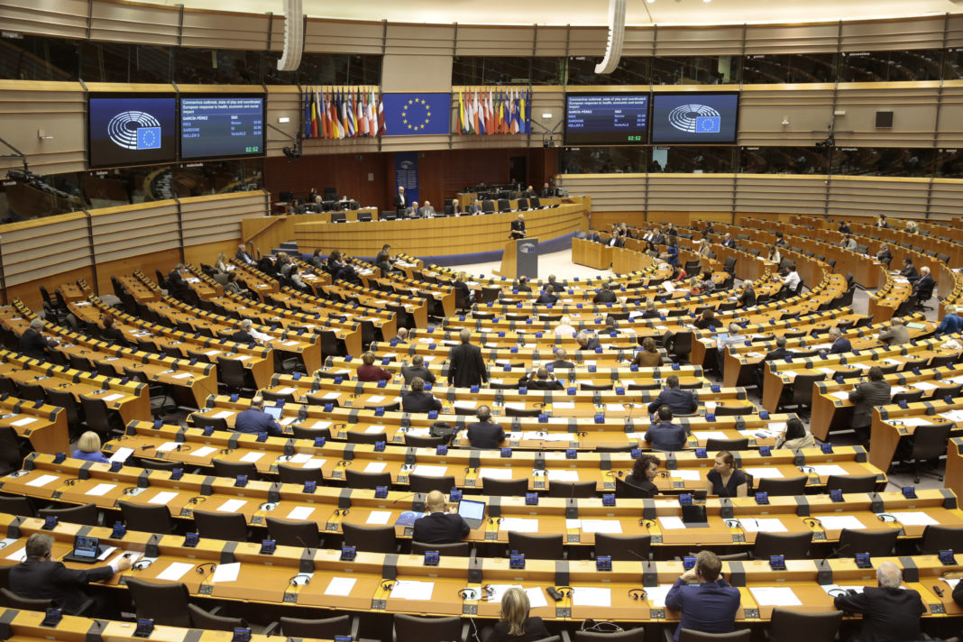
How and when did you became a representative in the European Parliament? What were the criterions?
Through the years she got into the Slovak Parliament as a representative. The Slovak parliament organized elections to the European Parliament for 13 candidates. She was elected and in 2004 she got into the European Parliament, and worked there for 10 years!

Slide 5
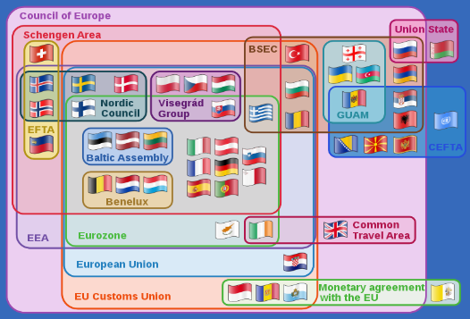
What were your goals?
This post brought missions and challenges for her and she successfully completed these. This opportunity guaranteed her and Slovakia to be represented and actively participate in the EU. Her interests were: family and woman rights and gender politics.

Slide 6
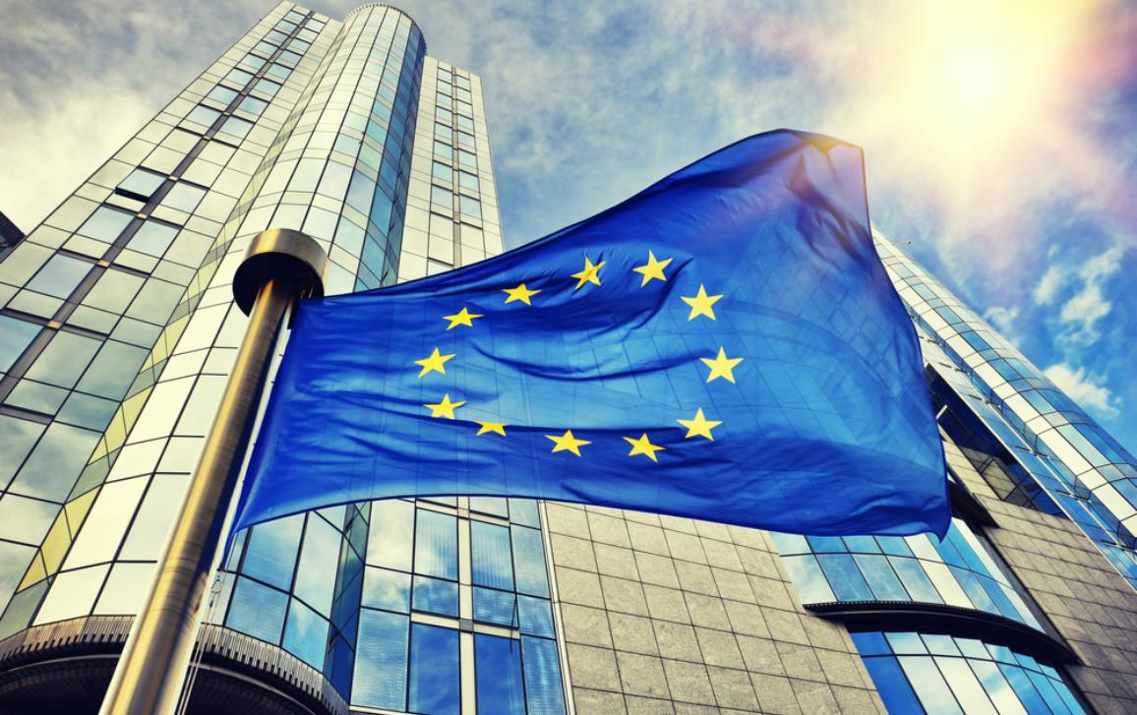
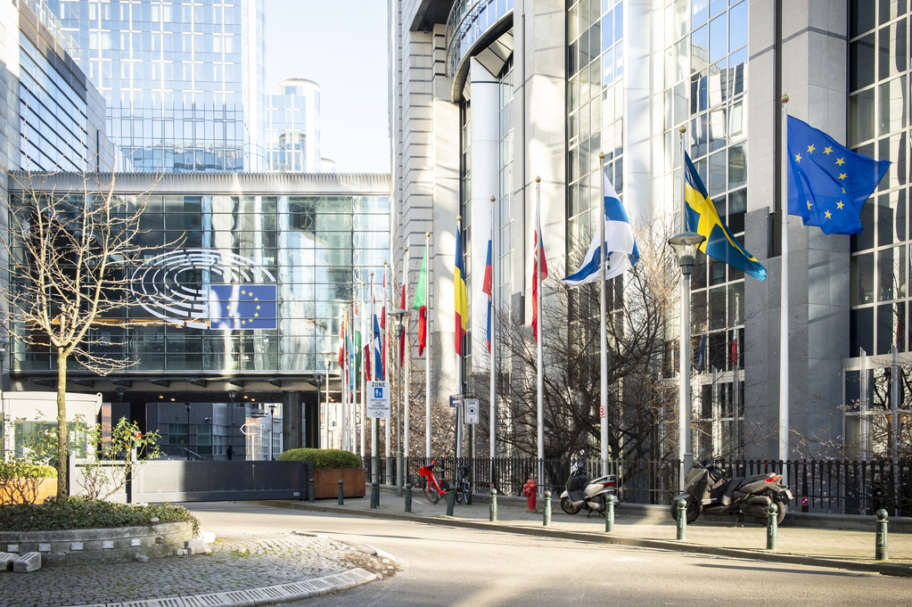
Slovakia joined the EU in 2004. How did the other member states react to Slovakia being a new member?
With doubts. The first countries, which joined the EU first, had nearly the same political views, so as a former eastern bloc country, they didn’t know what to expect.

Slide 7
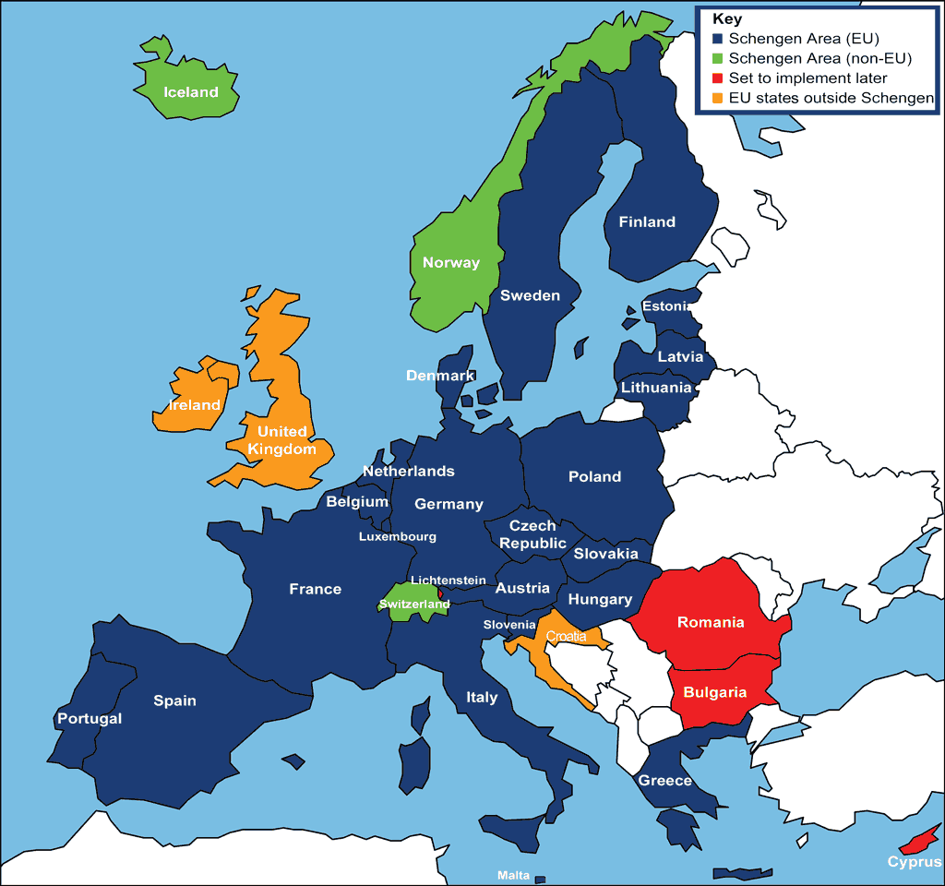
What do you think about the Schengen area?
On 16 April 2003, Slovakia signed the Schengen agreement. On 21 December 2007, it started the execution of this convention. Mrs. Bauer supports this and its expansion. It’s very effective to travel through countries without checking people’s passport.

Slide 8
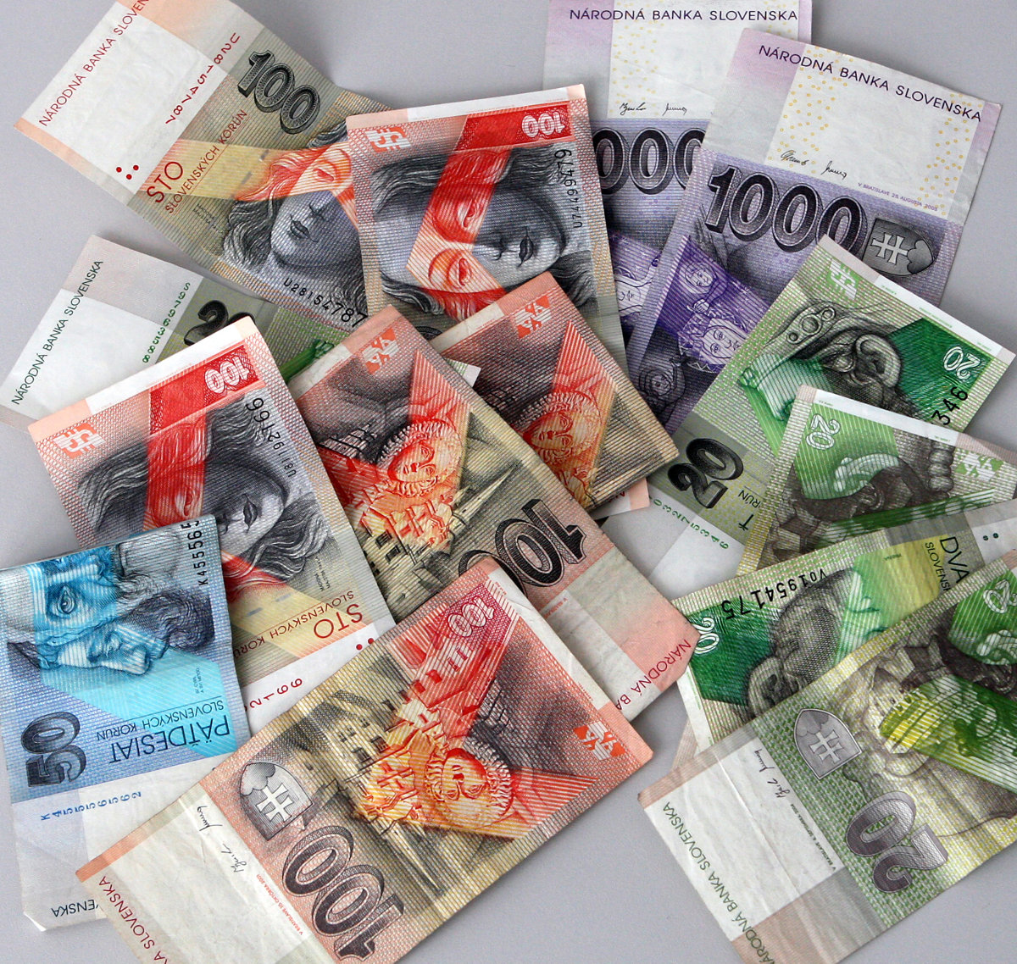
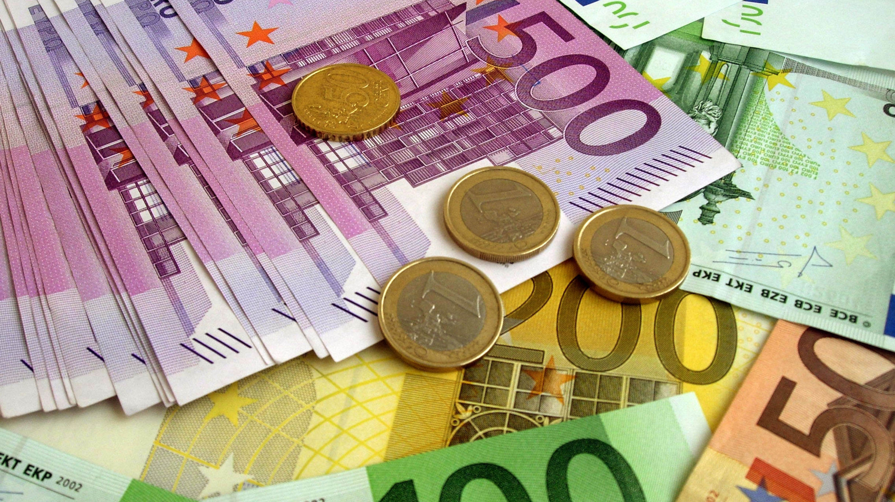
What do you think about the Euro? Should every European county adopt this currency?
We use the Euro since 2009, before that we used to use the Slovak koruna.
It would be hard to convince every member state to use the Euro, but if they did, we would have a common currency.

Slide 9
THANK YOU FOR YOUR ATTENTION!

