Slide 1
Comenius 2013-2015
Júlia Brňáková
Rebecca Grosschmidtová

Slide 2
Our Comenius Teachers Team

Slide 3
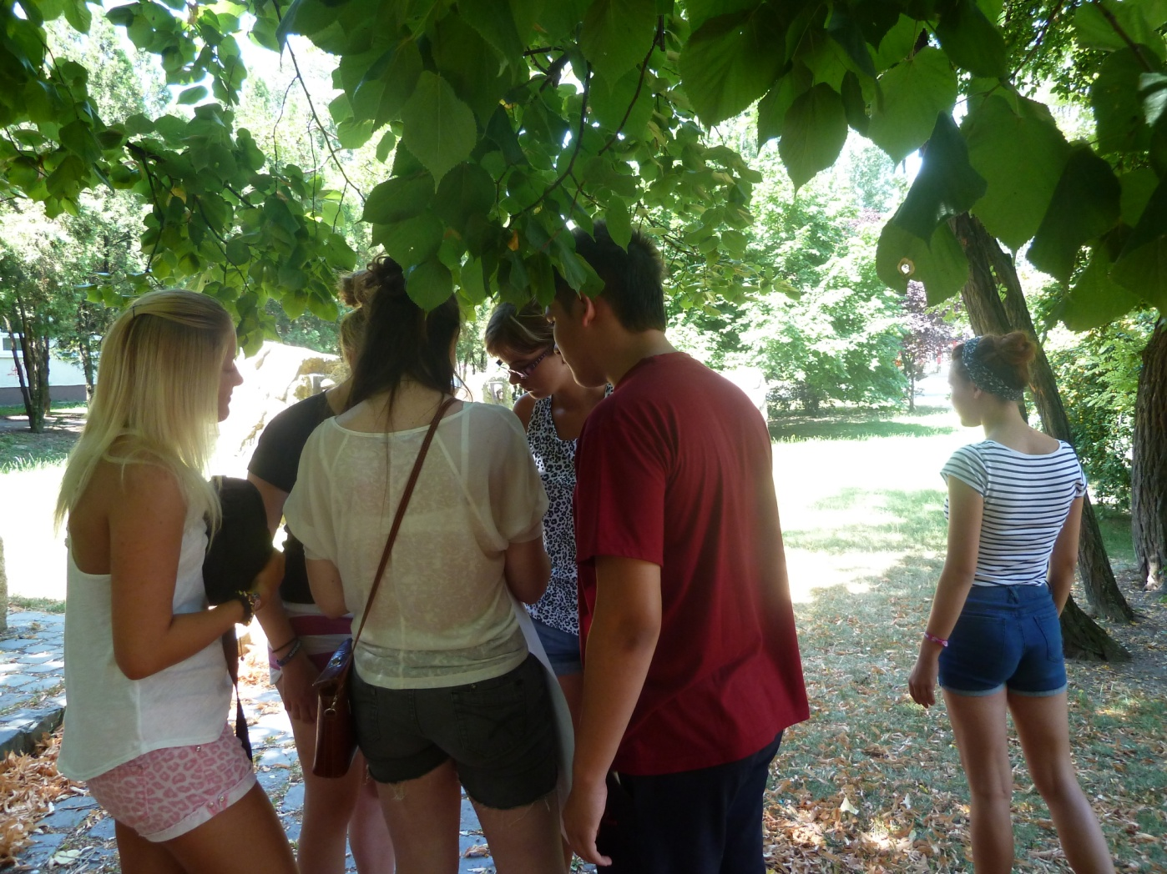
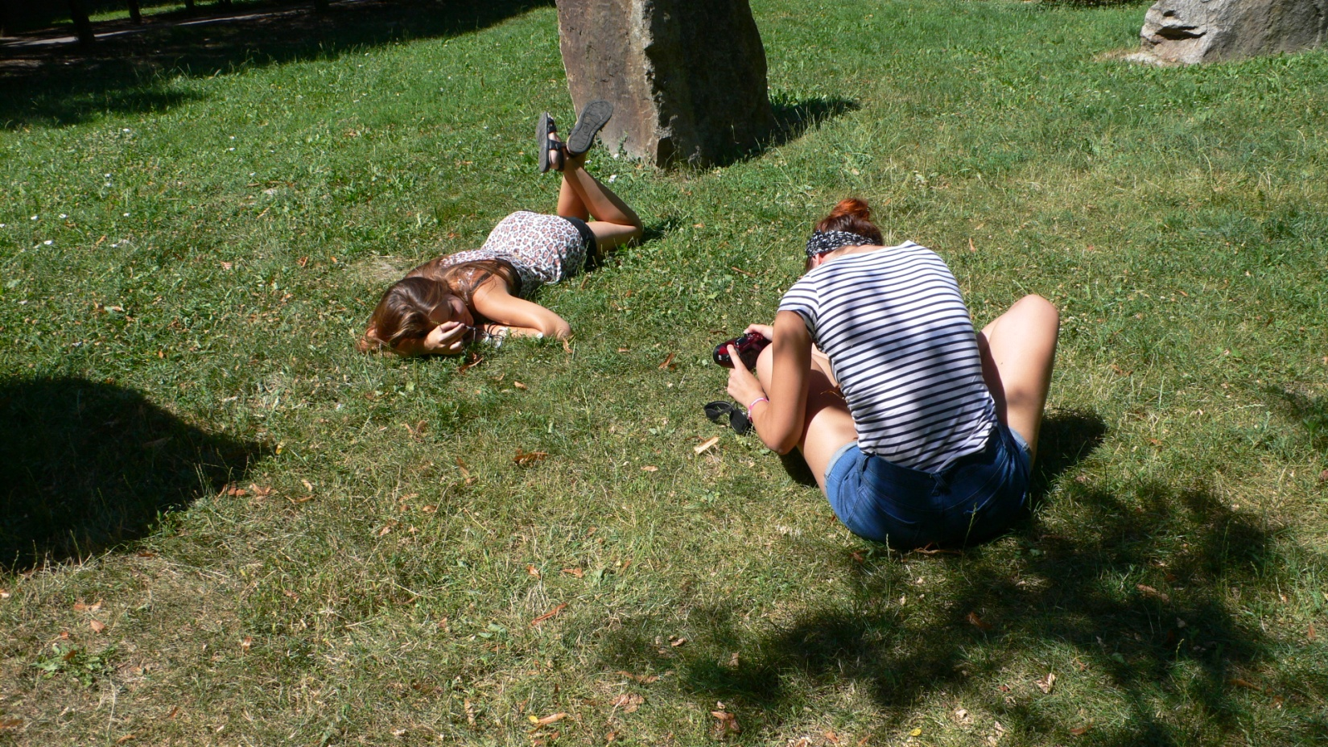
Founding a group of photographers

Slide 4
Photo of winner logo

Slide 5
Visitation house of handicapped people – 3.december

Slide 6
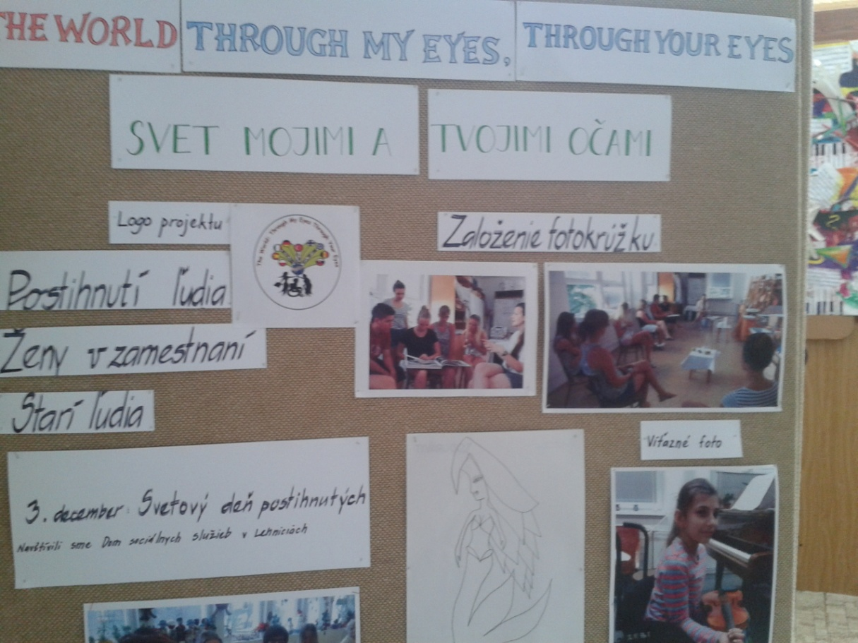
Comenius Corner

Slide 7
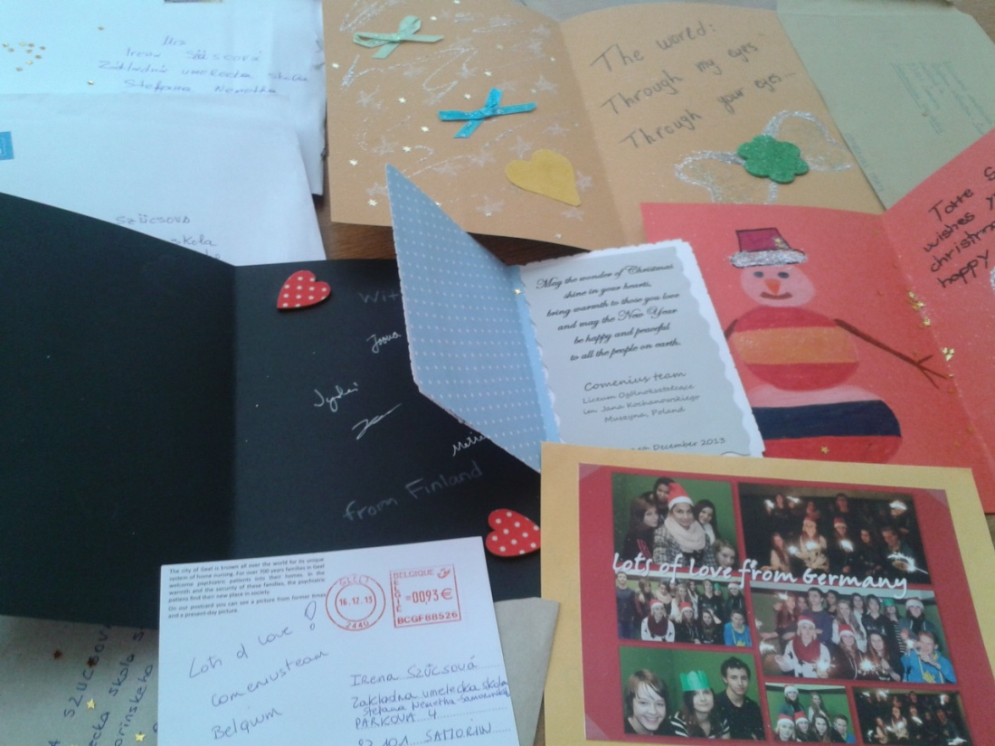
Christmas post cards

Slide 8
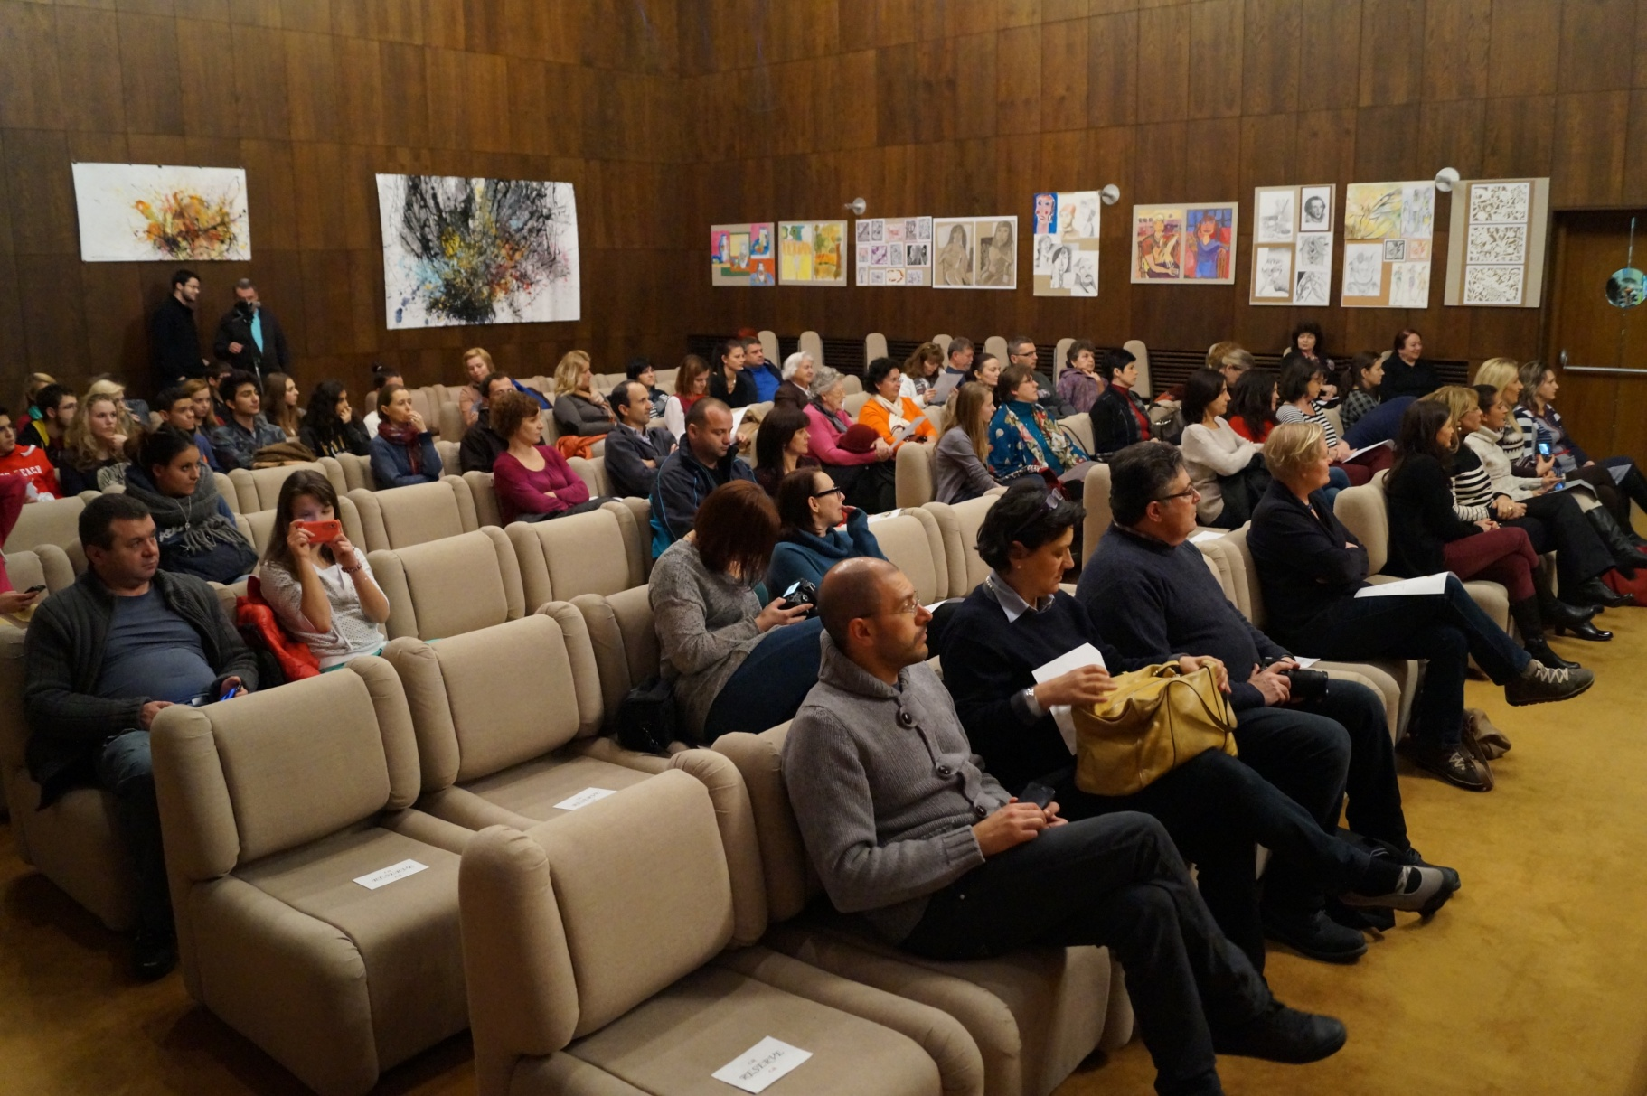
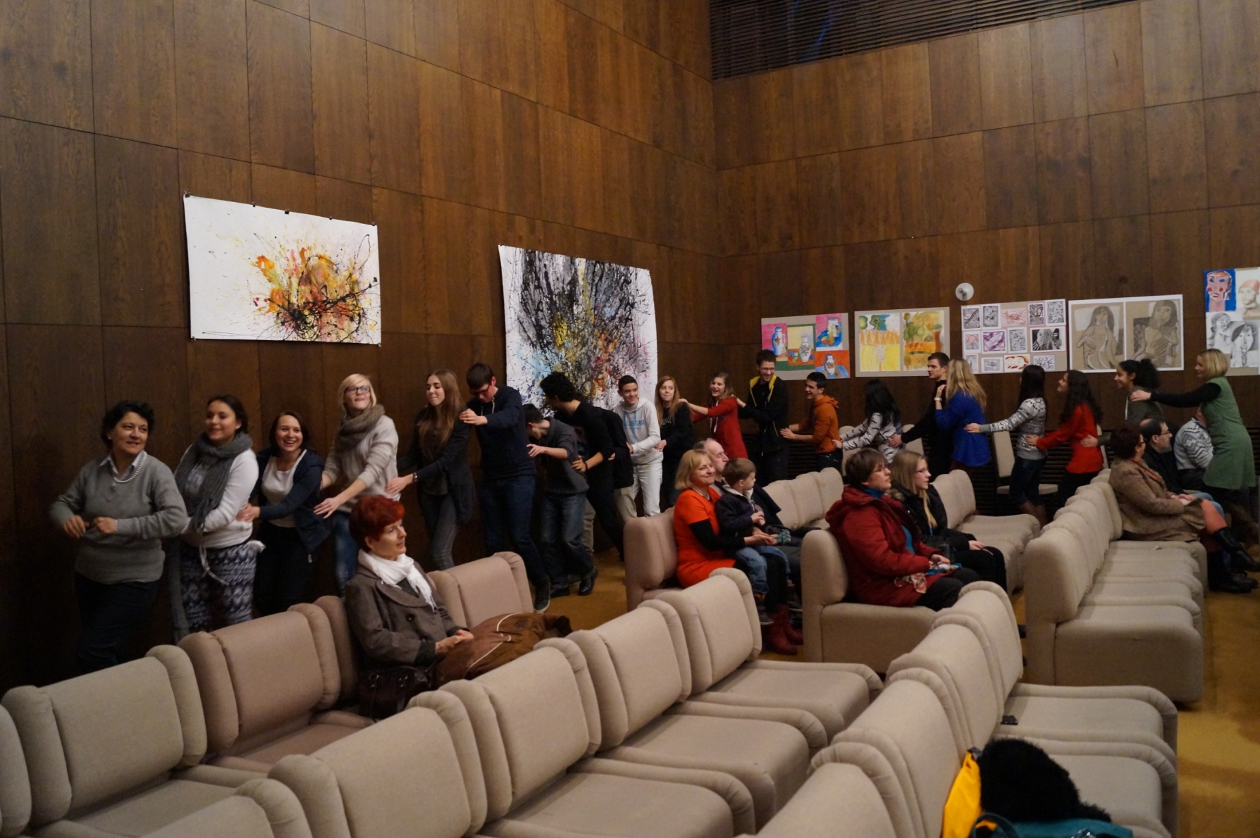
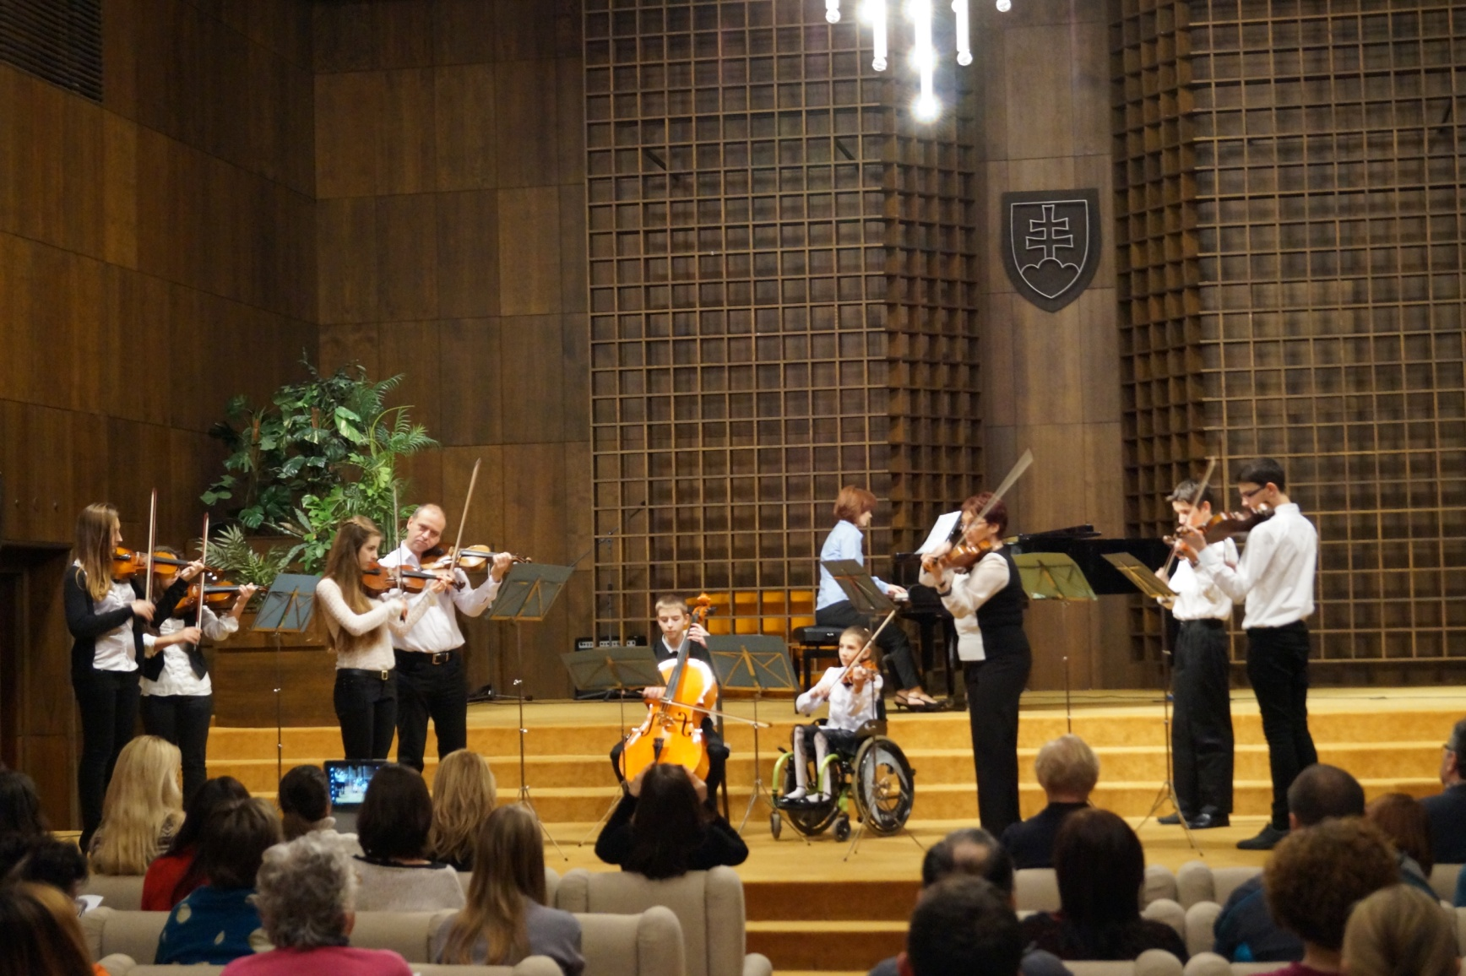
Meeting in Šamorín 2014

Slide 9
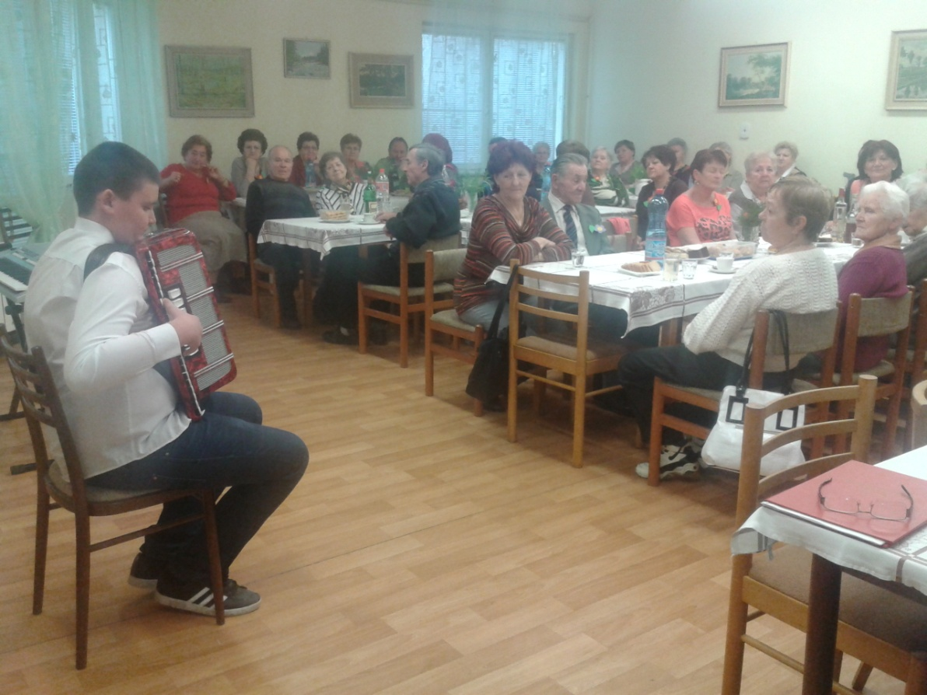
1. May – Europe day

Slide 10
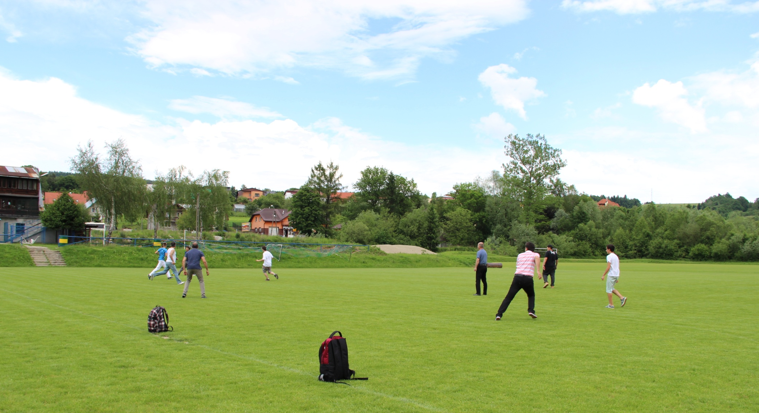
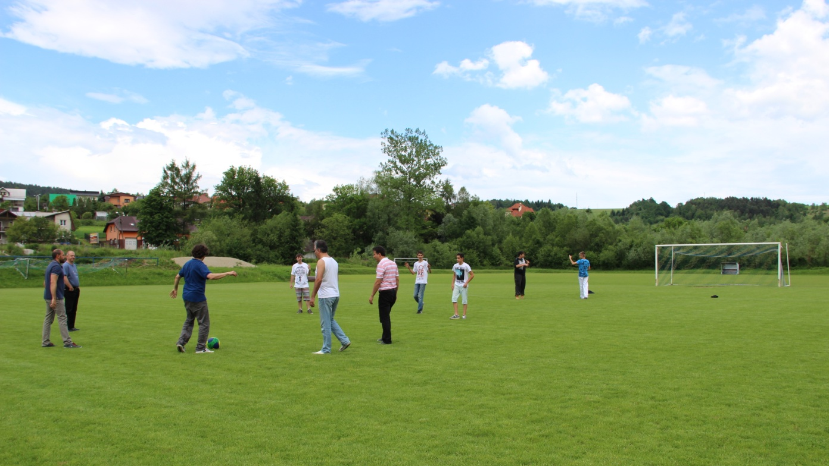
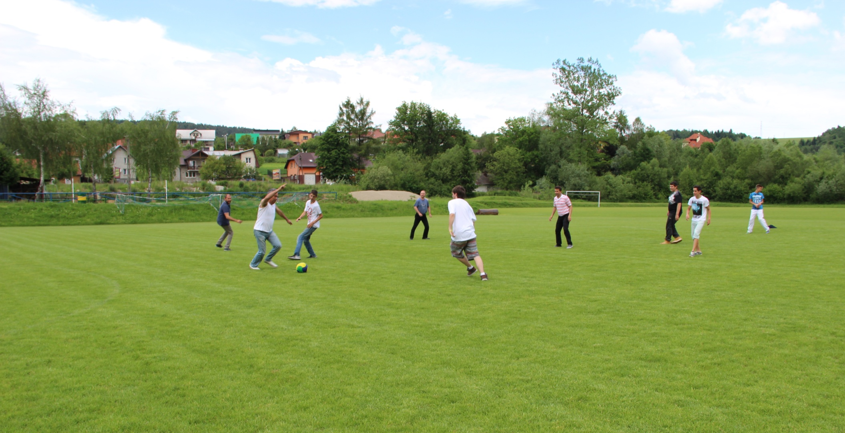
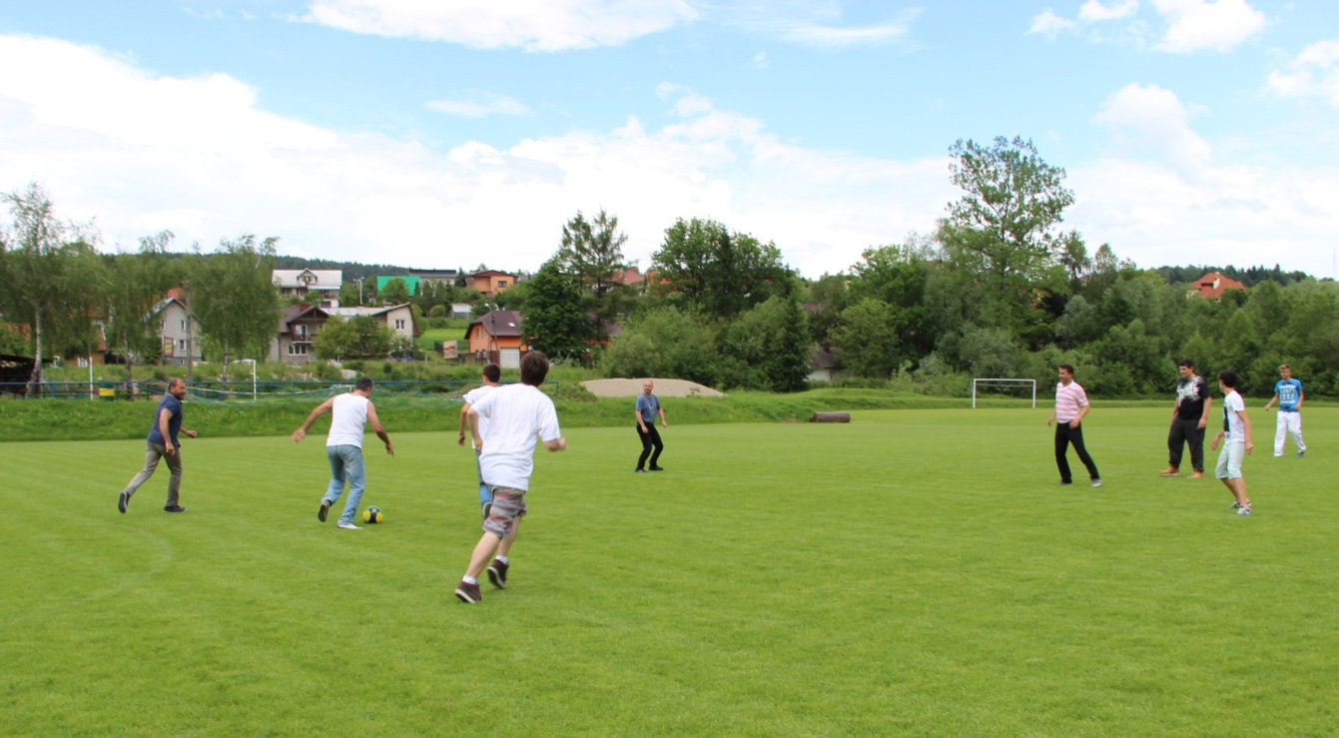
Meeting in Polland
International futball mach

Slide 11
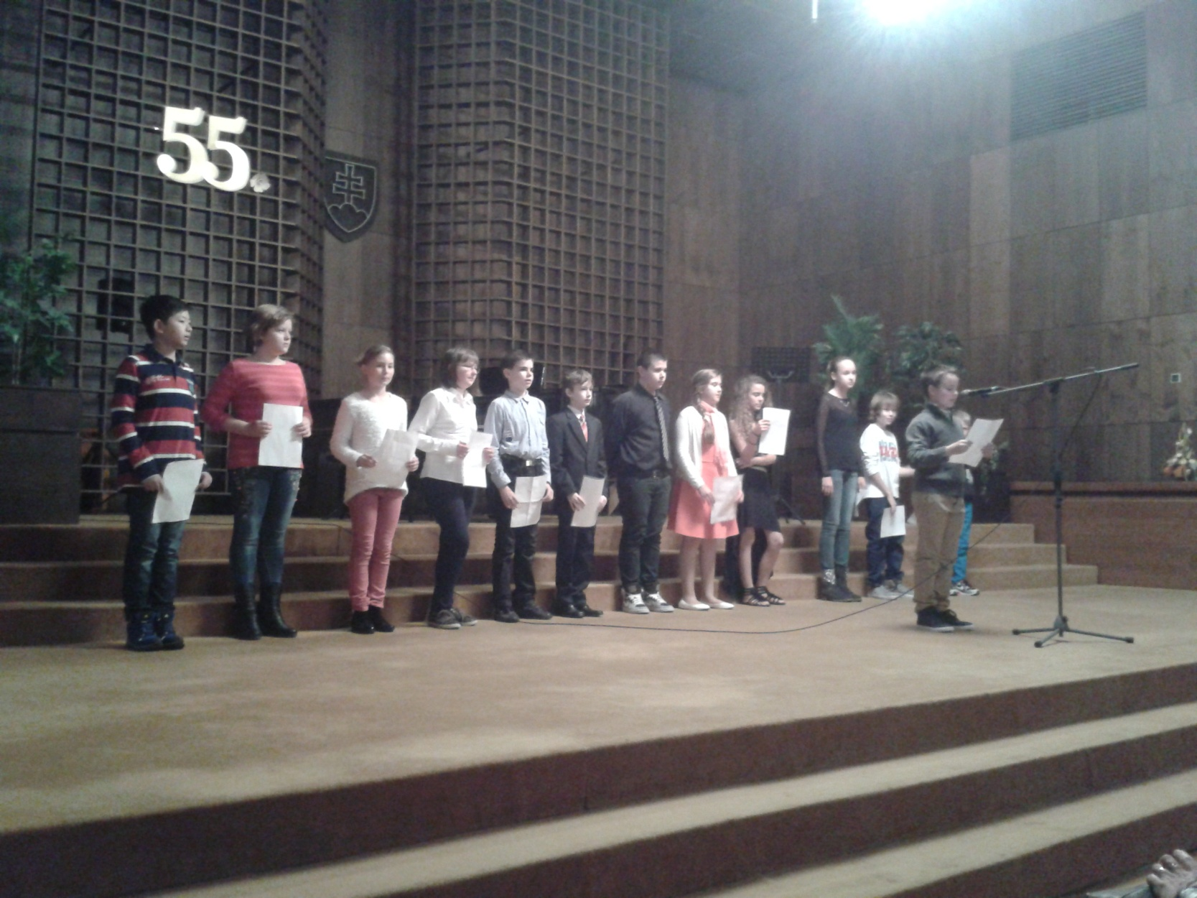
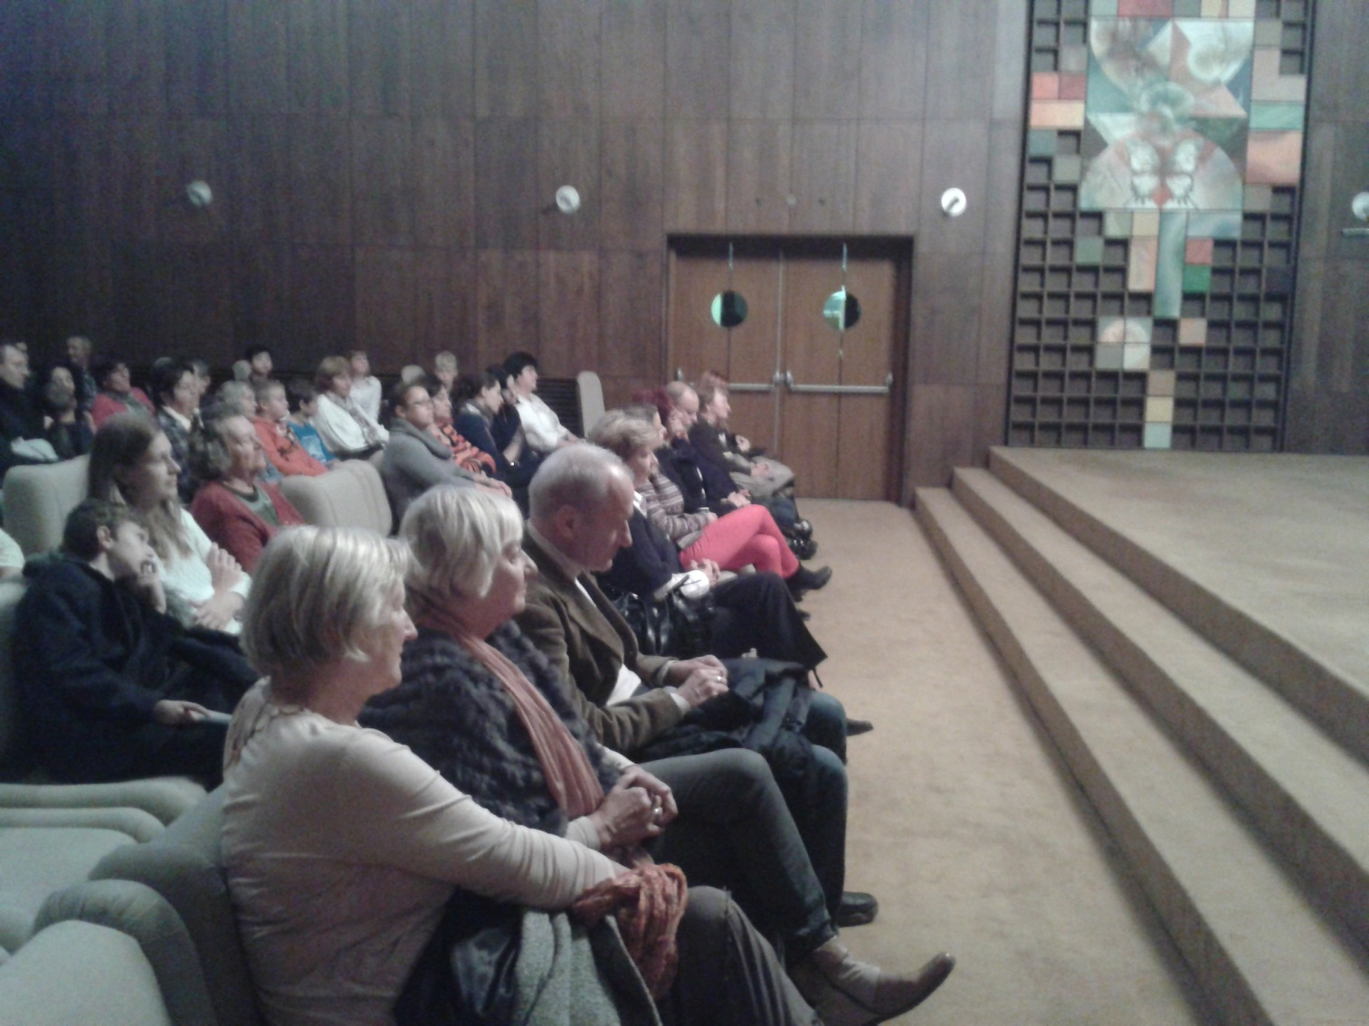
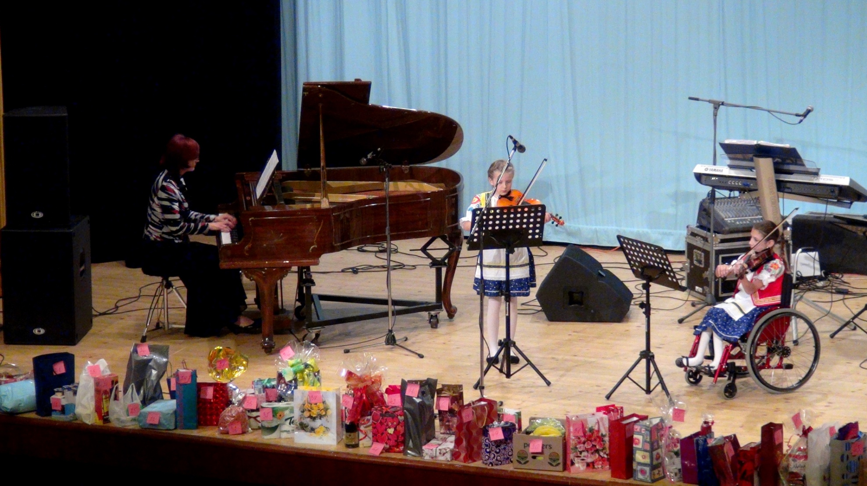
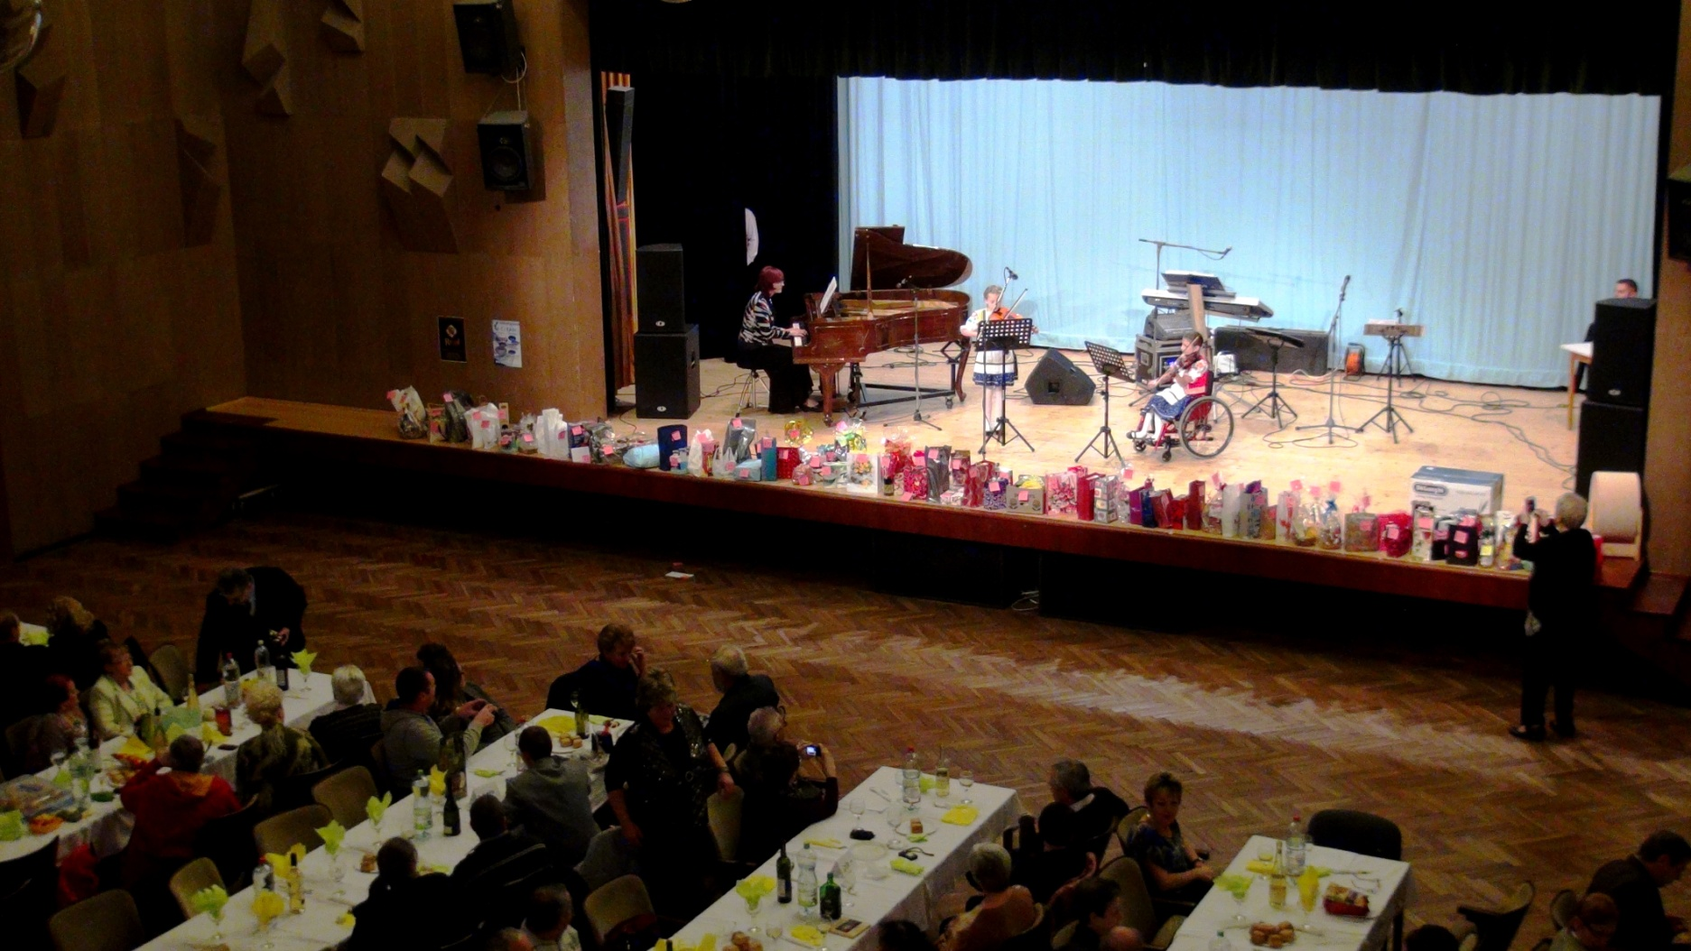
Day of elderly people

Slide 12
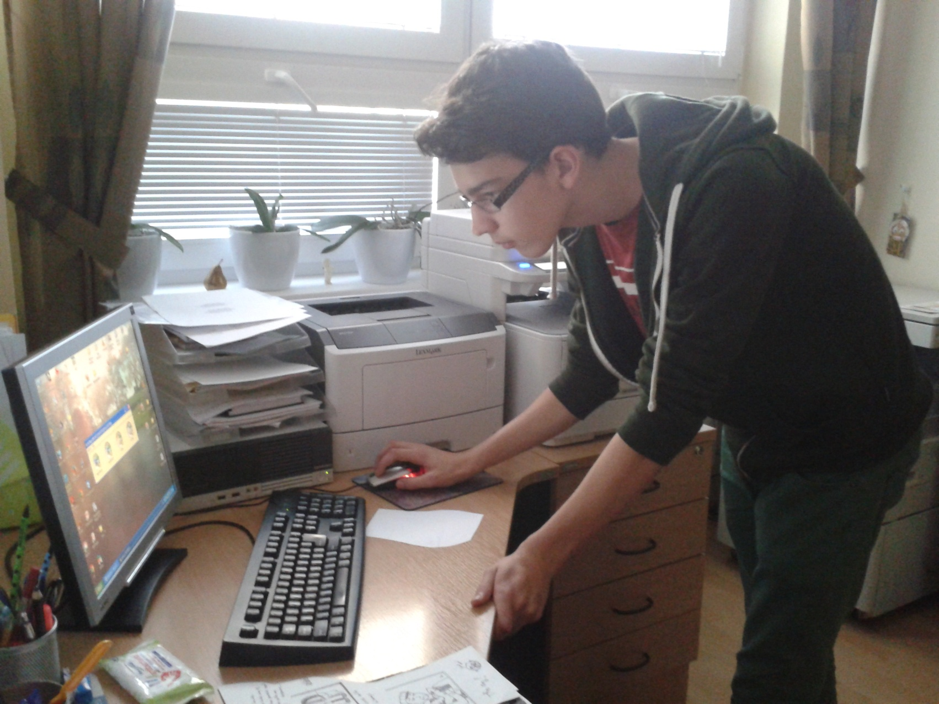
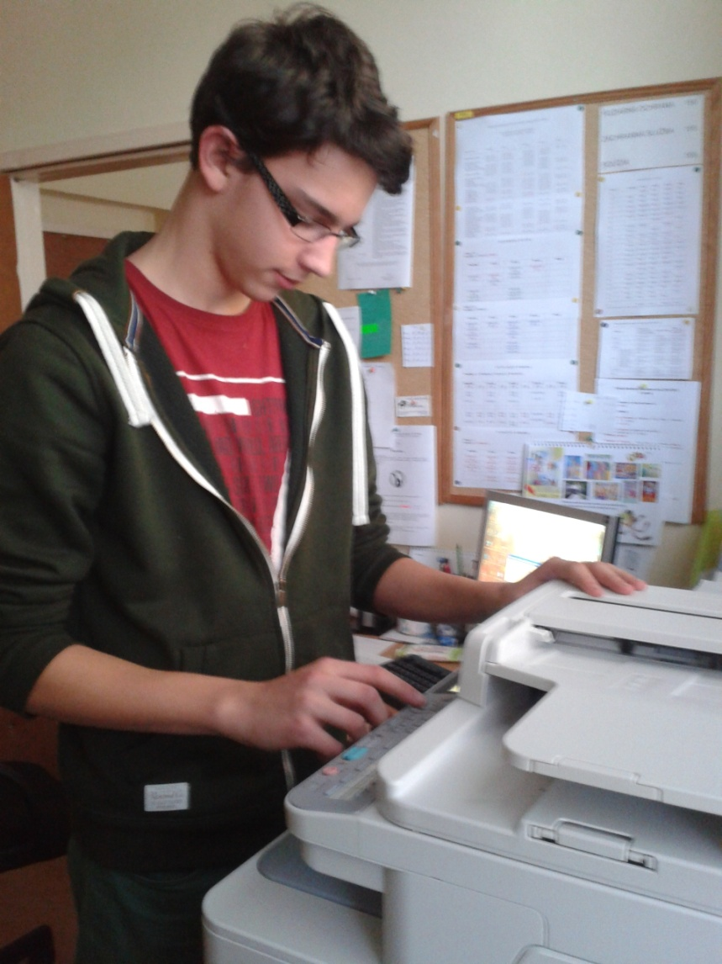
Storybook

Slide 13
Christmas postcards for partners

Slide 14
We made a short film about woman in Slovakia

Slide 15
Calendar

Slide 16
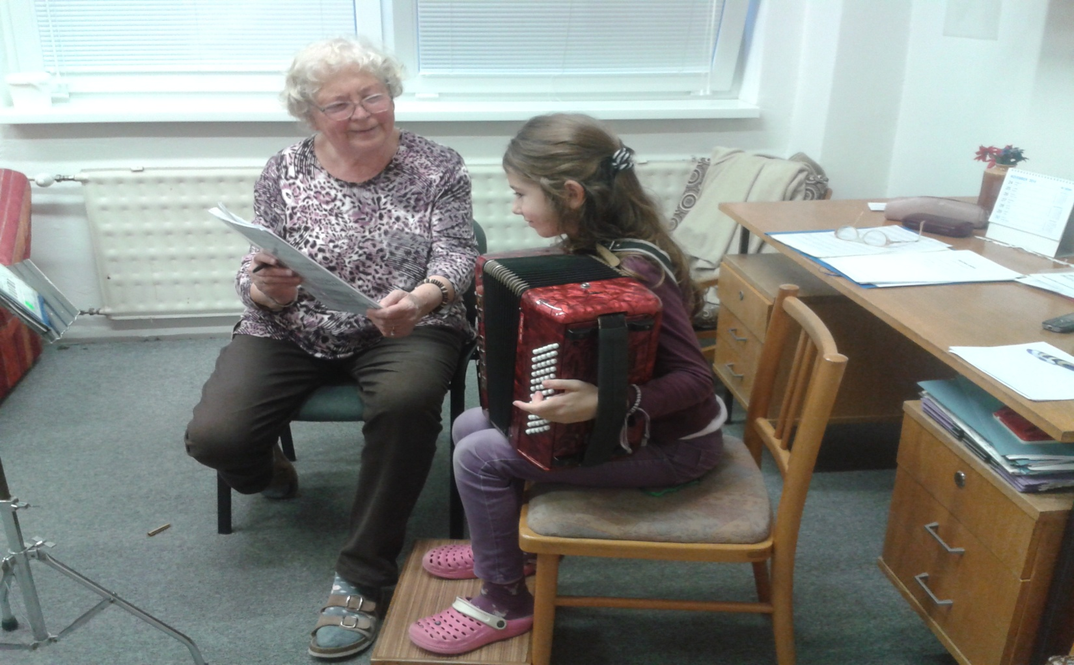
Winner photos
1. winner photo – Věra Hlaváčková (author G.Szűcs)

Slide 17
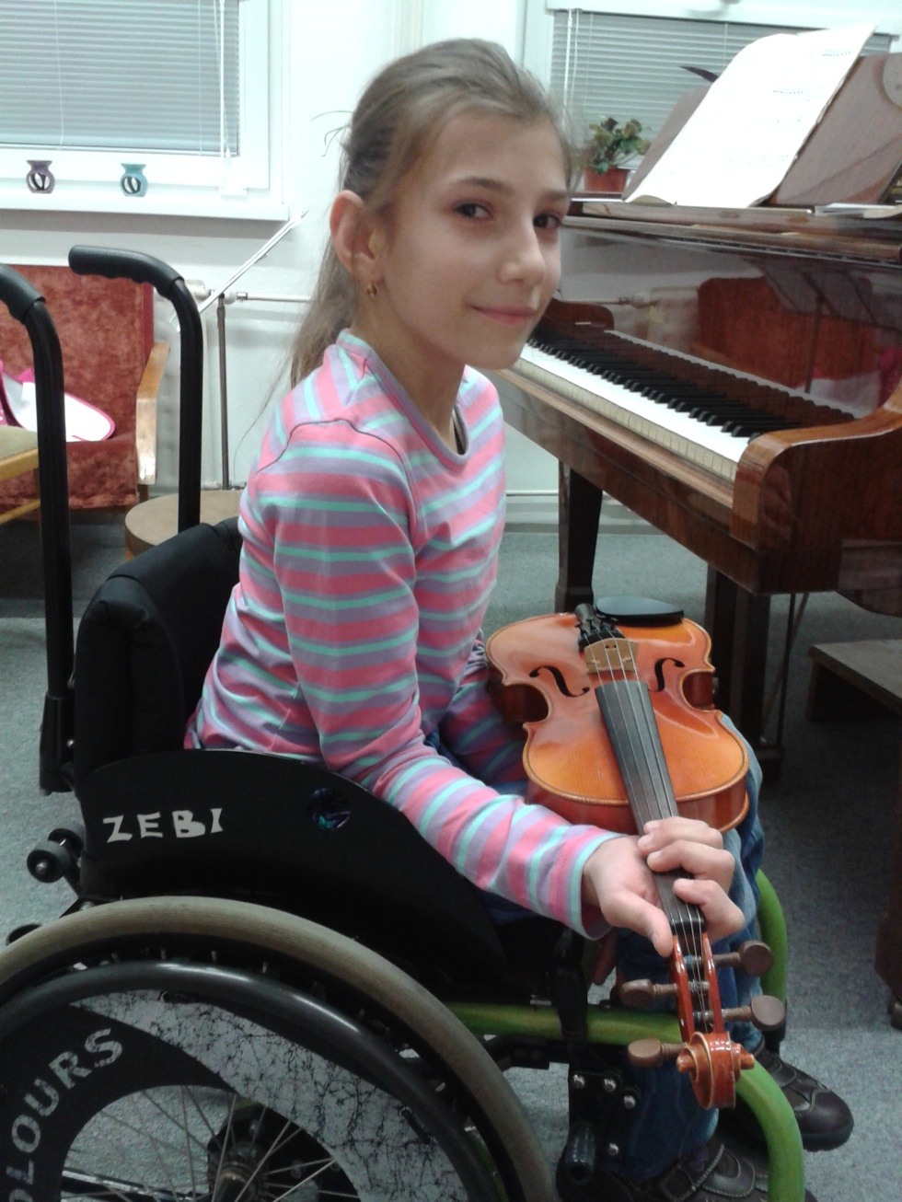
2. Winner photo - Rebeka Orbanová
(author D. Varga)

Slide 18
3. Winner photo – Enikő Baráthová
(author K. Baráthová)

Slide 19
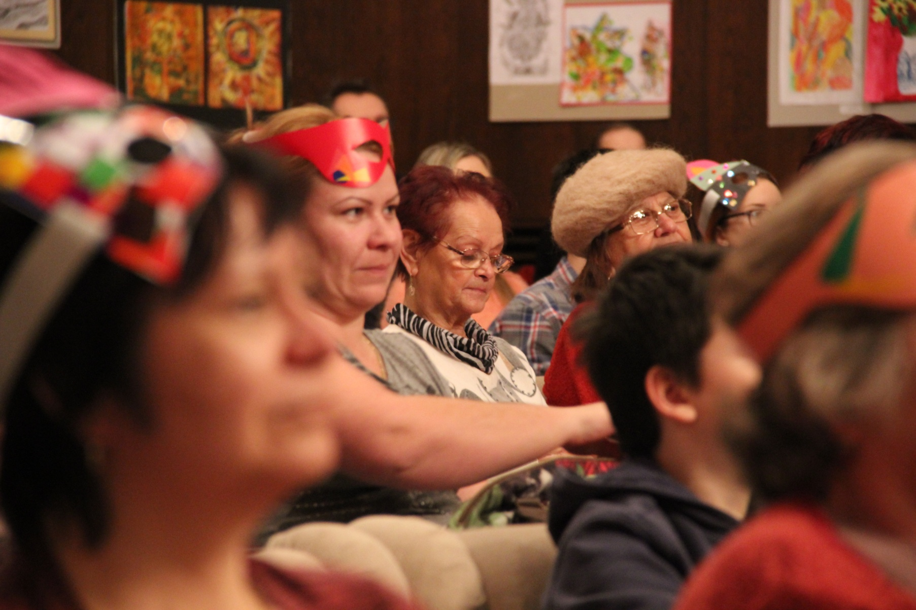
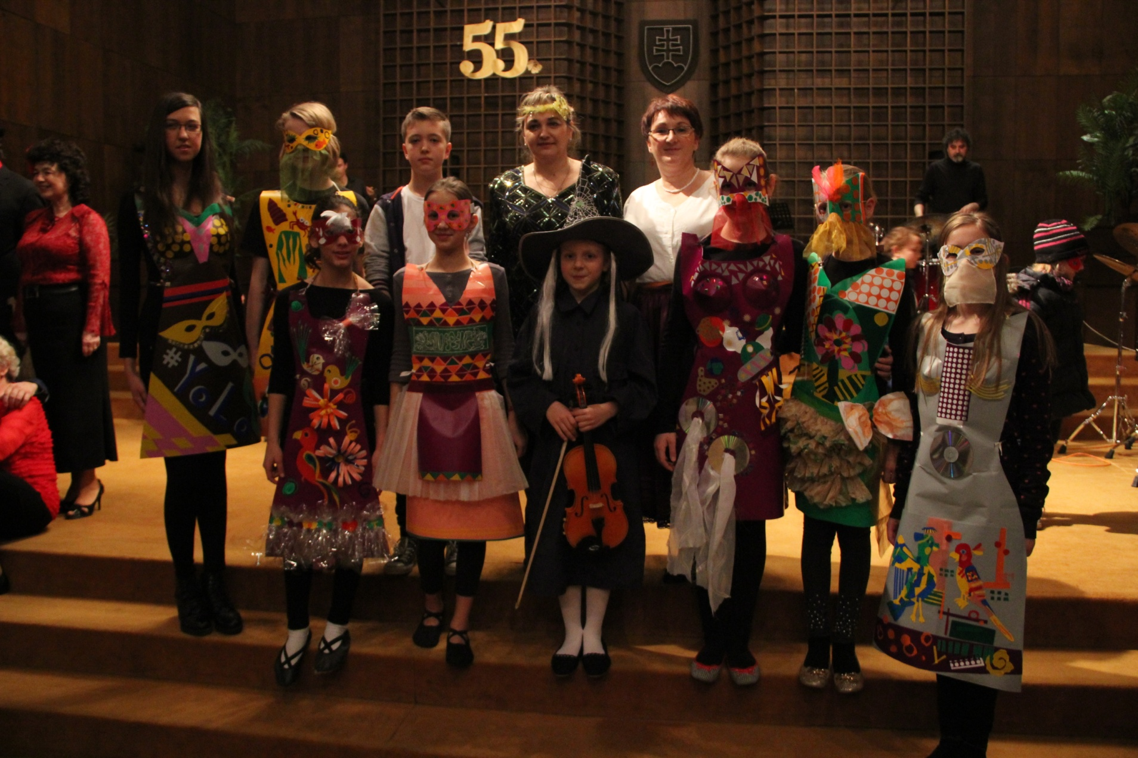
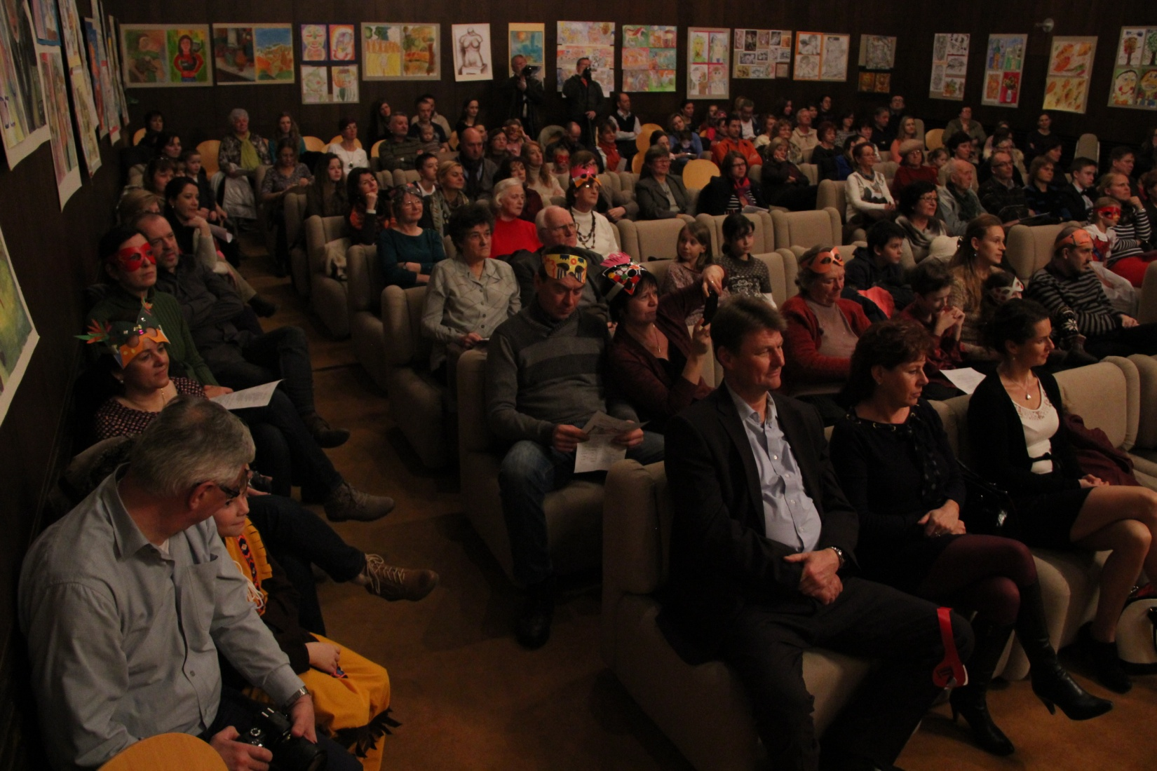
Carnival with mothers and grandmothers

Slide 20
Thanks for attention

