Slide 1
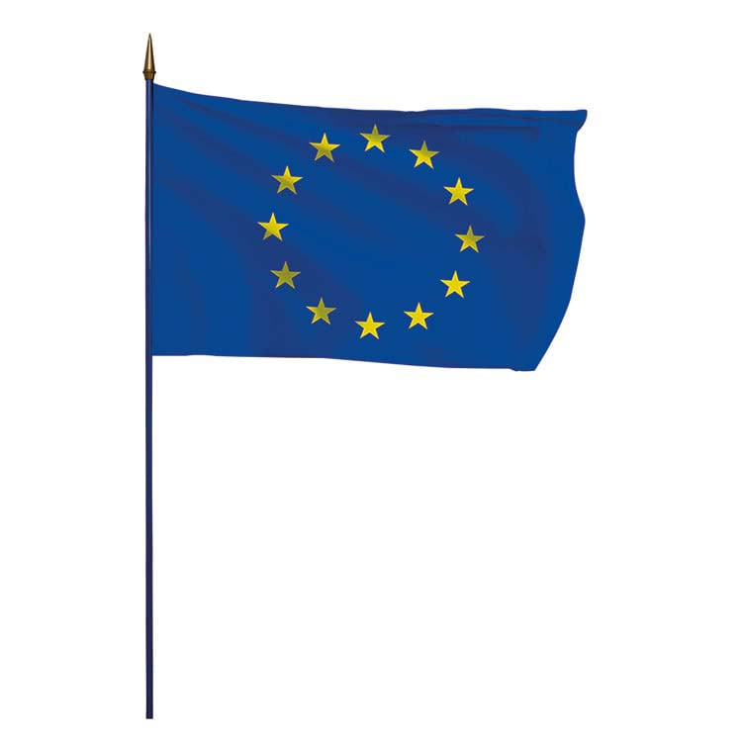
Europe

Slide 2
European Countries

Slide 3
EU member countries in brief
The enlargement of the European Union has seen a constant evolution; the number of member states is therefore expected to grow.
After the accession of Croatia on 1 July 2013, and the exit of the UK on January 31st, 2020, the EU counts now 27 member states which share common values​​.
A European citizen is free to live and work in all EU countries

Slide 4
Dutch, French
COUNTRY | CAPITAL | OFFICIAL EU LANGUAGE(S) | FLAG
AUSTRIA | Vienna | German
BELGIUM | Brussels | Dutch, French, German
BULGARIA | Sofia | Bulgarian
CROATIA | Zagreb | Croatian
CYPRUS | Nicosia | Greek
CZECHIA | Prague | Czech
DENMARK | Copenhagen | Danish
ESTONIA | Tallinn | Estonian
FINLAND | Helsinki | Finnish, Swedish

Slide 5
Dutch, French
COUNTRY | CAPITAL | OFFICIAL EU LANGUAGE(S) | FLAG
FRANCE | Paris | French
GERMANY | Berlin | German
GREECE | Athens | Greek
HUNGARY | Budapest | Hungarian
IRELAND | Dublin | Irish, English
ITALY | Rome | Italian
LATVIA | Riga | Latvian
LITHUANIA | Vilnius | Lithuanian
LUXEMBOURG | Luxembourg | French, German

Slide 6
Dutch, French
COUNTRY | CAPITAL | OFFICIAL EU LANGUAGE(S) | FLAG
MALTA | Valletta | Maltese, English
NETHERLANDS | Amsterdam | Dutch
POLAND | Warsaw | Polish
PORTUGAL | Lisbon | Portuguese
ROMANIA | Bucharest | Romanian
SLOVAKIA | Bratislava | Slovak
SLOVENIA | Ljubljana | Slovenian
SPAIN | Madrid | Spanish
SWEDEN | Stockholm | Swedish

Slide 7
European Institutions

Slide 8
European Parliament is one of three legislative branches of the European Union and one of its seven institutions. Together with the Council of the European Union, it adopts European legislation, commonly on the proposal of the European Commission. The Parliament is composed of 705 members. It represents the second-largest democratic electorate in the world (after the Parliament of India) and the largest trans-national democratic electorate in the world. The Parliament is headquartered in Strasbourg, France, and has its administrative offices in Luxembourg City. Plenary sessions take place in Strasbourg as well as in Brussels, Belgium, while the Parliament's committee meetings are held primarily in Brussels
European Council
is a collegiate body that defines the overall political directions and priorities of the European Union. It comprises the heads of state or government of the EU member states, along with the President of the European Council and the President of the European Commission. The High Representative of the Union for Foreign Affairs and Security Policy also takes part in its meetings. Established as an informal summit in 1975, the European Council was formalised as an institution in 2009 upon the entry into force of the Treaty of Lisbon. Its current president is Charles Michel, former Prime Minister of Belgium.

Slide 9
Council of the European Union often referred to in the treaties and other official documents simply as the Council, and informally known as the Council of Ministers, is the third of the seven Institutions of the European Union as listed in the Treaty on European Union. It is one of three legislative bodies and together with the European Parliament serves to amend and approve the proposals of the European Commission, which holds legislative initiative. The Council of the European Union and the European Council are the only EU institutions that are explicitly intergovernmental, that is forums whose attendees express and represent the position of their member state's executive, be they ambassadors, ministers or heads of state/government.
European Commission
is the executive branch of the European Union, responsible for proposing legislation, implementing decisions, upholding the EU treaties and managing the day-to-day business of the EU. Commissioners swear an oath at the European Court of Justice in Luxembourg City, pledging to respect the treaties and to be completely independent in carrying out their duties during their mandate.
The procedural languages of the commission are English, French and German. The Members of the Commission and their "cabinets" (immediate teams) are based in the Berlaymont building in Brussels.

Slide 10
Court of Justice of the European Union is the judicial branch of the European Union. Seated in the Kirchberg quarter of Luxembourg City, Luxembourg, this EU institution consists of two separate courts: the Court of Justice and the General Court. From 2005 to 2016 it also contained the Civil Service Tribunal. It has a sui generis court system, meaning ’of its own kind’, and is a supranational institution.
European Central Bank
is the central bank of the Eurozone, a monetary union of 19 EU member states which employ the euro. Established by the Treaty of Amsterdam, the ECB is one of the world's most important central banks and serves as one of seven institutions of the European Union, being enshrined in the Treaty on European Union. The bank's capital stock is owned by all 27 central banks of each EU member state. Headquartered in Frankfurt, Germany, the bank formerly occupied the Eurotower prior to the construction of its new seat.
The European Court of Auditors
is one of the seven institutions of the European Union. It was established in 1975 in Luxembourg in order to improve EU financial management.

Slide 11
The advisory bodies to the European Union are European Committee of the Regions, European Economic and Social Committee and Political and Security Committee.
An agency of the European Union
is a decentralised body of the European Union, which is distinct from the institutions. Agencies are established to accomplish specific tasks. Each agency has its own legal personality. Some answer the need to develop scientific or technical know-how in certain fields, others bring together different interest groups to facilitate dialogue at European and international level. There are more than forty agencies as European Environment Agency, European Institute of Innovation and Technology, European Centre for Disease Prevention and Control, Fundamental Rights Agency, European Labour Authority.

Slide 12
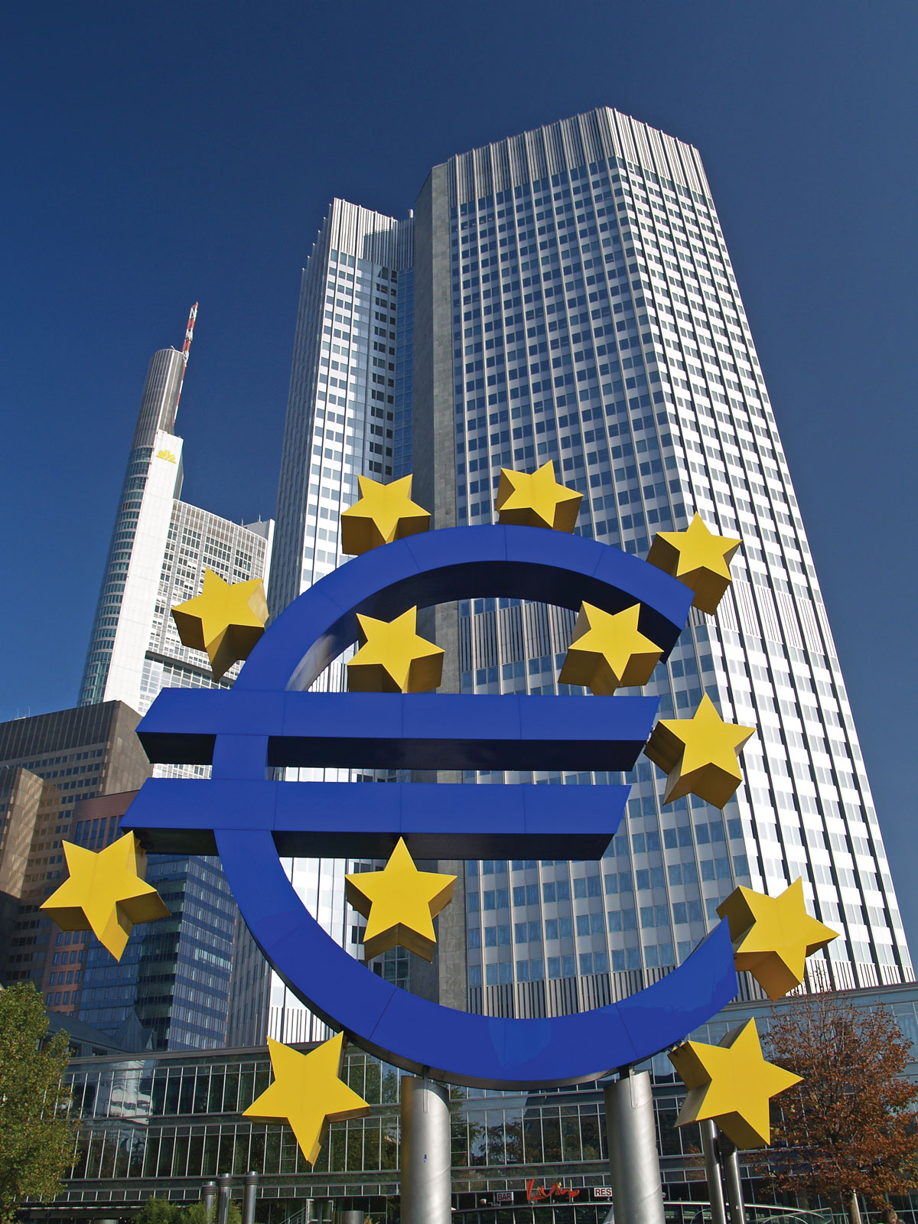
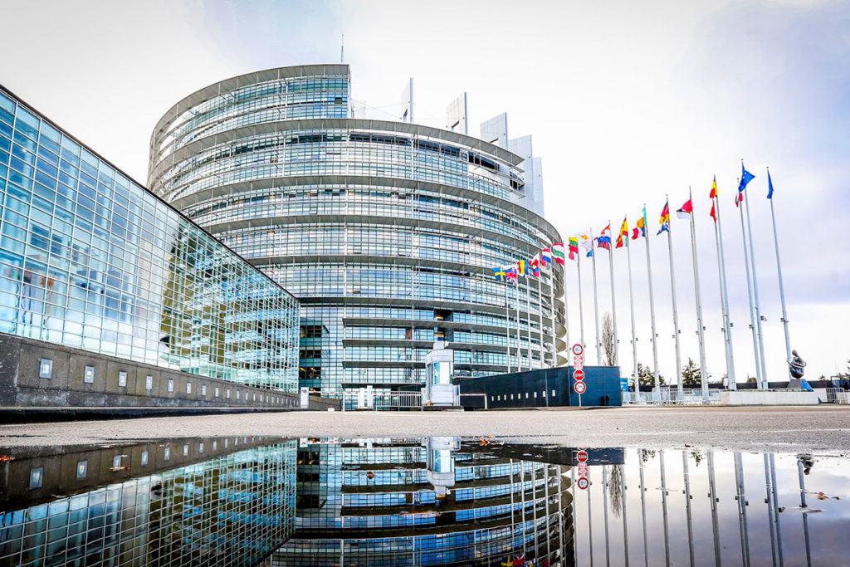

Slide 13
European history
1945 - 1979

Slide 14
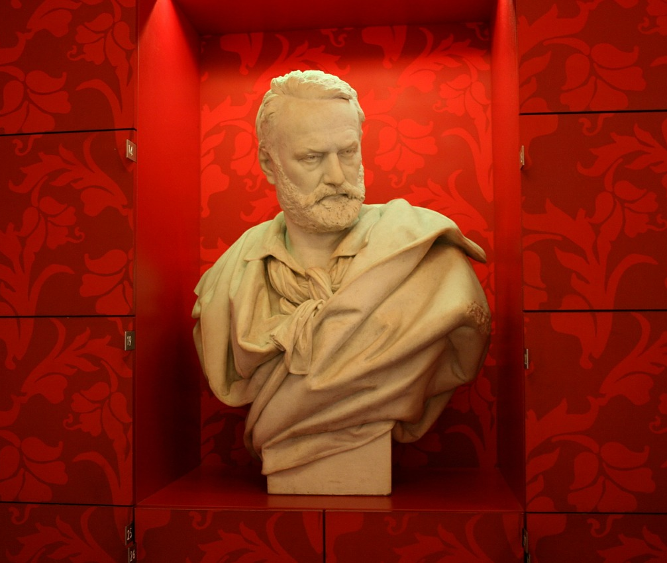
VICTOR HUGO’S SPEECH
“A day will come when we shall see those two immense groups, the United States of America and the United States of Europe, stretching out their hands across the sea, exchanging their products, their arts, their works of genius […] And to bring about that day will not take another 400 years, for we are living in a fast-moving age.”

Slide 15
1945-1959(1/2)
The historical roots of the European Union lie in the Second World War that ended 2.9.1945
Europeans were determined to end the frequent and bloody wars
Soon after the the Second World War, Europe was split into the East and West as the 40-year-long Cold War began.

Slide 16
1945-1959 (2/2)
West European nations created the Council of Europe in 1949
That was considered to be the first step towards cooperation between western countries
Belgium, France, Germany, Italy, Luxembourg and the Netherlands wanted to go further with cooperation
French foreign minister Rubert Schauman presented a plan for deeper cooperation in May 9 1950
Later, every May 9 is celebrated as Europe Day
European Coal and Steel community (ECSC) was created in the early 1952
Treaty of Rome was signed March 25 1957
Created the European Economic Community (EEC) → The idea was that people, goods and services could move freely across borders

Slide 17
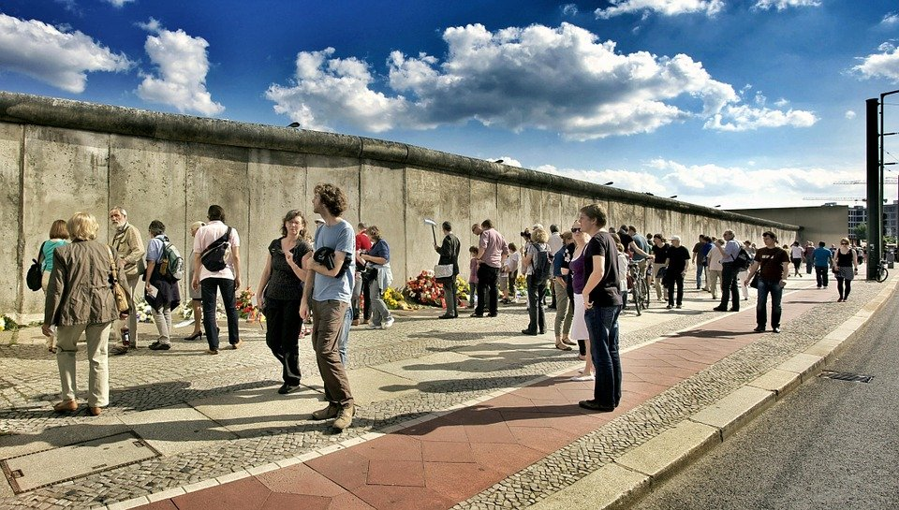
1960 - 1969
The 60s was a good period for the economy
In August 1961, the communist authorities in East Germany started to build a wall across Berlin to prevent their citizens from escaping to the west
In July 1968 Belgium, France, Germany, Italy, Luxembourg and the Netherlands removed custom duties on goods imported from each other
That allowed free cross-border trade for the first time → trade grew rapidly worldwide.

Slide 18
1970
European Union expanded in January 1973 when Denmark, Ireland and the United Kingdom joined it.
The world faced a big oil crisis in 1973 which restircted sales to certain European countries. That created economic problems in Europe.
In 1979 members of the European Parliament were elected directly for the first time by EU citizens.

Slide 19
Sources
https://www.thenewfederalist.eu/170-years-since-victor-hugo-s-speech-about-the-united-states-of-europe?lang=fr (accessed November 27, 2020)
https://europa.eu/european-union/about-eu/history/1945-1959_en (accessed November 30, 2020)
https://europa.eu/european-union/about-eu/history/1960-1969_en (accessed November 30, 2020)
https://europa.eu/european-union/about-eu/history/1970-1979_en (accessed November 30, 2020)
Seppo Zetterberg. Maailman historian pikkujättiläinen (pages. 891-897). WSOY, 1993

Slide 20
European history
1980 – today

Slide 21
1980-1989
In 1981 Greece becomes the 10th member of the EU.
In 1986 Spain and Portugal follow.
With the fall of the Berlin Wall on November 9, 1989 Germany is finally reunited again.
source: https://europa.eu/european-union/about-eu/history_en#1980-1989ps_en#1980-1989

Slide 22
1990-1999
In 1993 a single market is created, bringing Europe closer together:
freedom of movement of goods, services, people and money
In 1995 Austria, Finland and Sweden become members of the European Union.
The Schengen Agreement is signed, allowing Europeans to travel without having their passports checked.
source: https://europa.eu/european-union/about-eu/history_en#1980-1989ps_en#1980-1989

Slide 23
2000-2009
The Euro is now the currency for many Europeans.
In 2004 ten new countries join the European Union.
In 2007 Bulgaria and Romania become members of the European Union.
In 2008 the financial crisis hits the European economy.
source: https://europa.eu/european-union/about-eu/history_en#1980-1989ps_en#1980-1989

Slide 24
2010-today
Climate change becomes a more and more important topic.
The European Union is awarded the Nobel Peace Prize in 2012.
In 2013 Croatia joins the European Union.
In 2016, the UK decides to leave the European Union.
Due to unrest and wars, many people leave their home and seek refuge in the Europe.
In spring 2020 the corona pandamic reaches Europe and has a severe impact.
source: https://europa.eu/european-union/about-eu/history_en#1980-1989ps_en#1980-1989

Slide 25
Europe Aims and goals

Slide 26
Objectives
The European Union’s main objective is to promote peace, follow the EU’s values and improve the wellbeing of nations. The European Parliament and other institutions see to it that these objectives are achieved.

Slide 27
* A common European area without borders
The objective is to create a free and safe Europe with no internal borders. The citizens living in the area enjoy the rights granted by the European Union.
* Internal market
The objective is to ensure smooth and efficient trade within Europe. Competition between companies is free and fair.
* Stable and sustainable development
The objective is to ensure Europe’s sustainable and steady development. It means balanced economic growth and stable prices. The European Union seeks to create a competitive market economy which takes into account people’s wellbeing and social needs. An important issue is environmental protection. Efforts are made to protect the environment and repair any damage made.
* Scientific and technological development
The European Union supports the advancement of science and technology and invests in education. Another objective is to achieve a skilled workforce and a high standard of technological production.

Slide 28
* Prevention of social exclusion
The European Union works hard to prevent social exclusion. It seeks to prevent people from drifting outside the labour market and society. Efforts are made to eliminate poverty. The Union works for equality. Minority rights are protected. Social security is improved. Men and women must be treated equally. Children’s rights must be protected and children given a happy childhood. Old people must be looked after and respected.
* Solidarity
Solidarity between countries and people is promoted in the field of the economy, social equality and regions. The member states must be loyal to one another. It means that states must take responsibility for and be understanding of one another.
* Respect for languages and cultures
The European Union respects the languages and cultures of the individual countries. National cultures and the common European culture are cherished and developed.

Slide 29
* Common foreign and security policy
The European Union seeks to promote peace not only in Europe but also elsewhere in the world. It seeks to ensure that peace is maintained in Europe and that people have security. With the common foreign policy, the European Union wants to make sure that the resources of the planet are used sensibly and that the environment is not destroyed. The European Union also wishes to respect other countries and nations. It works for free and fair trade and tries to eliminate poverty. Human rights are important all over the world. The European Union follows the Charter of the United Nations and underlines the importance of common international rules.
The European Union’s general objectives are recorded in the Treaties of the European Union.
From https://europarlamentti.info/en/values-and-objectives/objectives/

