Slide 1
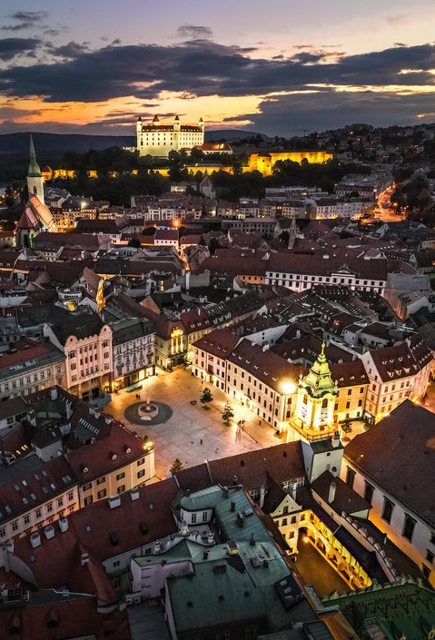
I'm European because...

Slide 2
We are Europeans because we were born here, and we've lived here in our whole life
We were born in Slovakia, Bratislava
For us Europe is our home, where we can study, and where we can grow up
Our family, our roots and our mother language binds us here too
We profess European values like freedom, peace and equality
We are also proud to our history, our forefather did many things for our country and for Europe too.

Slide 3
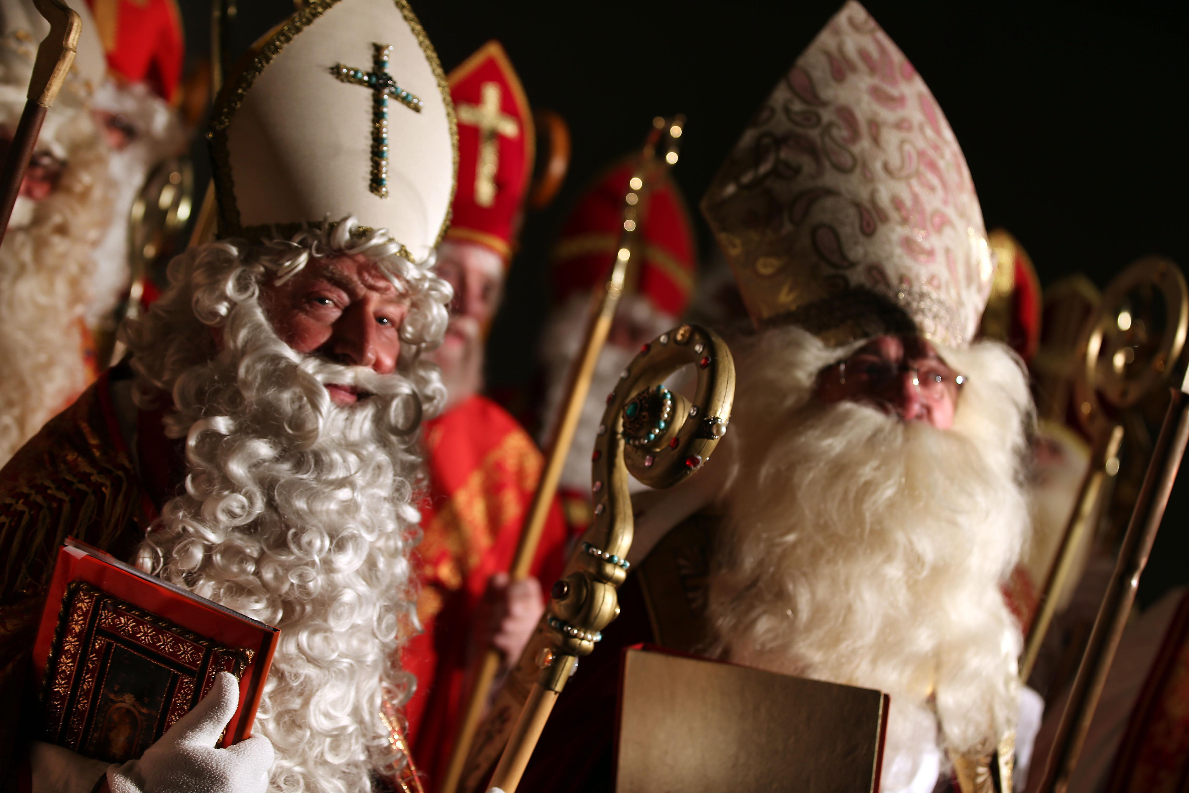
We have many special traditions, both Slovak and Hungarian
Water, parfume and whicker whips for Easter : they believed cold water would make the girls healthy. Nowadays men sprinkle with water or parfume. Girls are expected to give the boys boiled egg or sweets as a thanks
St. Nicholas day : on 6th of December St. Nicholas with an angel and a devil went around the houses giving out presents to children

Slide 4
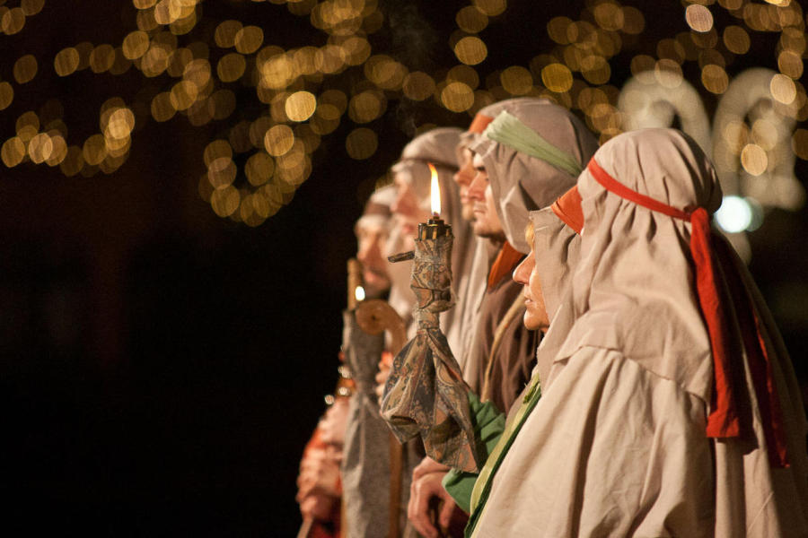
Carnival here called Farsang, and it's celebrated with food, parties and costumes. Especially kids like to dress up to these costumes.
Also common thing is Busójárás
Spring Festival is in March, folk and gypsy play music and dance groups perform
Like in America caroling, here are regölés, is also singing good wishes during Christmas time
And because we are christians, we celebrate Advent, this is a period beginning four Sundays before Christmas

Slide 5
For me Europe is...

Slide 6
Because we live in Europe there are many things easier for us
We can travel to other countries quite easily, all we need is a passport and a ticket
We can also study abroad, especially when we attend universities
Many schools offer opportunities for other countries to do many exchange programs like Erasmus
The European Union also helps entrepreneurs the most - from funding to coaching, and from supporting business networks to exchange programs.

Slide 7
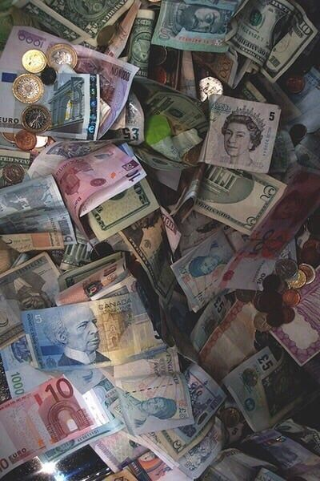
Europe is also trying to help build various facilities such as sports, transport and tourism in general in the countries.
We can pay with Euro in the countries which are in the eurozone, so we don't have to exchange money
We have an European medical card, this gives some kind of safety when we have issues

Slide 8
˝the European union is the most successful invention for advancing peace˝
- John Bruton -

